Slide 1

Security and Privacy
Searchable Encryption
Notes:
Hello everyone, today we are going to learn about how to search data without beaching Privacy.

Slide 2
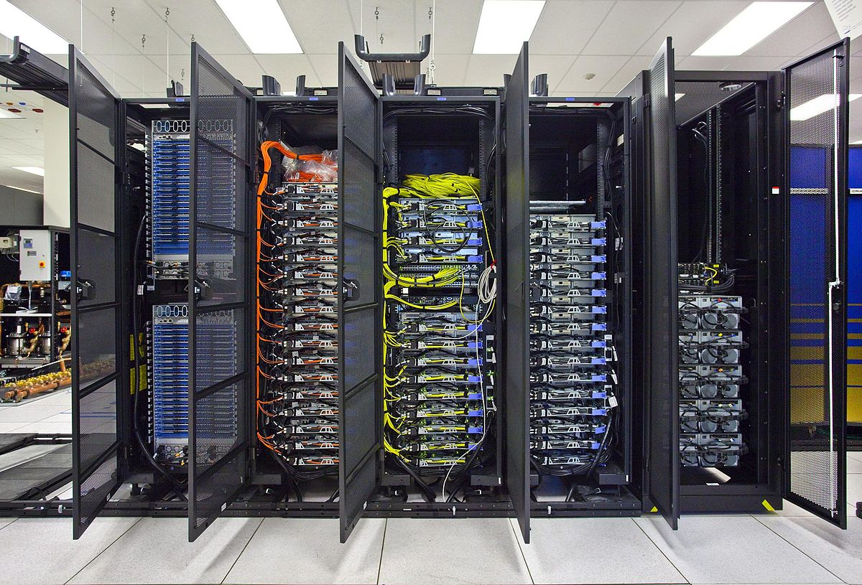
Search on Data on Remote Machine
Problem: use external computing power to search my data
E.g., data on cloud
What to search, Who can search
Goal: Maintain confidentiality!
Even if the data holder (e.g., cloud provider) is not trustable
Notes:
Nowadays it is very common to store data in external systems like cloud. So we will need to do the search on these external systems on our own data.
What is the problema? Confidentiality, right? What can be searched? Who can seach ...

Slide 3


Search on Data on Remote Machine
Problem: use external computing power to search my data
E.g., data on cloud
What to search, Who can search
Goal: Maintain confidentiality!
Even if the data holderv (e.g., cloud provider) is not trustable
Basic Scneario
Upload my data, fully encrypted
(maybe I had it already stored remotely)
Need to run a search
must include Decrypt, search, Encrypt
Receive the result of search
Notes:
You may say, okay, we will encrypt everything on cloud
Then what we need to do? We need to descrypt data, make a search and the encrypt the results ... Receive the results
This was does not preserve confidentiality

Slide 4
Search on Data on Remote Machine
Problem: use external computing power to search my data
E.g., data on cloud
What to search, Who can search
Goal: Maintain confidentiality!
Even if the data holderv (e.g., cloud provider) is not trustable
Scneario
Upload my data, fully encrypted
(maybe I had it already stored remotely)
Need to run a search
must include Decrypt, search, Encrypt
Receive the result of search
To preserve confidentiallity:
Solution1:
Download all data
Decrypt data
Perform search
Erase decrypted data
Limitations
- Comunication overhead
- Computation effort for client
- Why would we be using cloud?
Notes:
What can we do to preserve considentiality?
The firstsimolified idea come to mind is to

Slide 5
Search on Data on Remote Machine
Problem: use external computing power to search my data
E.g., data on cloud
What to search, Who can search
Goal: Maintain confidentiality!
Even if the data holderv (e.g., cloud provider) is not trustable
Scneario
Upload my data, fully encrypted
(maybe I had it already stored remotely)
Need to run a search
must include Decrypt, search, Encrypt
Receive the result of search
Solution2:
Server does the search:
- Server decrypt the data
- Server runs the query
- Server sends only the results back to user
Limitations
- server to learn the plaintext data

Slide 6
Is it possible to search over encrypted data?
Notes:
Is it possible to search over encrypted data?

Slide 7
Searchable Encryption
Remote and cloud storages are used for backups or store data, reducing operational costs
These remote servers cannot be trusted
administrators, or hackers with root rights can have a full access to data
Sensitive data must be encrypted before moving
Reduces security and privacy risks
Encryption prevents insiders and outsiders to access data without the keys
but it is hard to search data ☹
Objective: Search functionality on the server side
Without decrypting data
With the smallest possible loss of data confidentiality
Notes:
So we need a sort of searchable encryption solution
Let’s formulate the problem again

Slide 8
Searchable Encryption Objectives
Data should be
Remote
Always encrypted
What should be confidential?
Source data
Search keywords
Search results
Owner/client defines
What to search
Who can search
Owner/client must not
Download all data
Compute much
Wait for long time
Notes:
Low communication overhead
Low computation overhead
And low response time

Slide 9
Encrypting Data
Using “good” encryption solves confidentiality problems, but
Querying parts of data (e.g., retreving records for a patient with certain ID) is hard/impossible
Because “good” encryption algorithms are randomized
The stored Enc_{k}(ID) is different from Enc_{k}(ID) when we want to search the data
Good security
No search functionality

Slide 10
Deterministic Encryption
Deterministic encryption (DE)
For exact matching
Order preserving encryption (OPE)
For range querying
Limitation: Leak too much information (equality)
Indistinguishability under chosen-plaintext attack (IND-CPA): It is a notion of security that ensures an adversary cannot distinguish between different ciphertexts corresponding to different plaintext
Bad security
Great funcionality and efficiency
Notes:
Shortly, the adversary should not be able to guess what the plaintext is out of the ciphertext

Slide 11
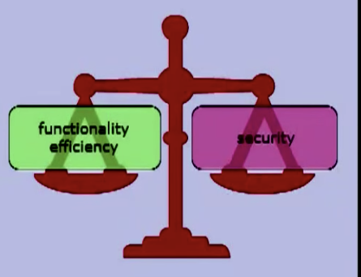
Requirements
Faster than linear search
Provably satisfying well-defined security properties appropriate to the applications

Slide 12
Search on Data on Remote Machine
Goal: use external computing power to search my data
Req: Maintain confidentiality!
Even if the owner is not trustable
Upload my data, dully encrypted
(maybe I had it already stored remotely)
Need to run a search
must include Decrypt, search, Encrypt
search on the encrypted data
Receive the result of search
✅
✅
✅

Slide 13
Song-Wagner-Perrig
“Practical Techniques for Searches on Encrypted Data”, S&P’00
First practical scheme for searching in encrypted data
Symmetric key, single keyword search
Perform a sequential scan without an index
Basic Scheme
Encrypt each word separately (use deterministic crypto)
To search, the server extract the hash value and check

Slide 14
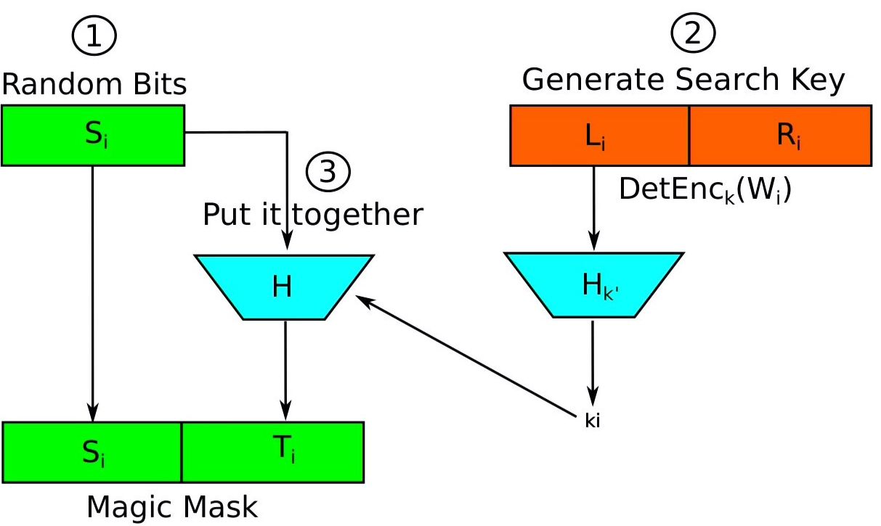
Basic Scheme for Encrypting
Alice wants to encrypt a document which contains the sequence of words W_{1, …,} W_{i}
Alice generates a sequence of pseudorandom values S₁ , …, S_{i} using some stream cipher (namely, the pseudorandom generator G), where each S_{i} is n - m bits long.
Alice generates search key (K_{i})
To encrypt a n-bit word W_{i} that appears in position i, Alice takes the pseudorandom bits S_{i} , sets T_{i} := <S_{i} , F_{ki} (S_{i})> , and outputs the ciphertext C_{i} := W_{i} xor T_{i} .
Note that only Alice can generate the pseudorandom stream T₁ , …, T_{i} so no one else can decrypt.
How k_{i} is chosen?
One possibility is to use the same key k at every word in the document.
Another alternative is to choose a new key ki for each word in position i independent of all other keys

Slide 15
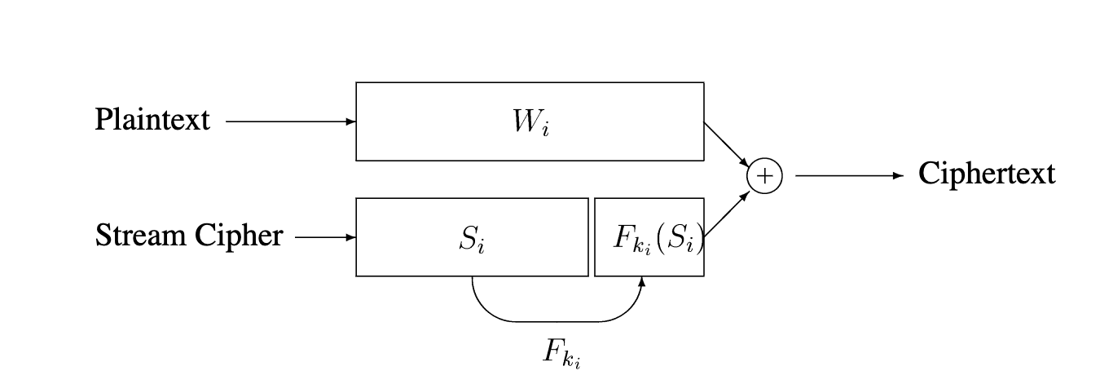
Basic Scheme for Encrypting

Slide 16
Search using Basic Scheme
The basic scheme supports searches over the ciphertext in the following way:
Alice wants to search the word W, she can tell Bob W and the k_{i} corresponding to each location i where a word W may occur.
Bob can then search for W in the ciphertext by checking whether C_{i} XOR W_{i} is of the form <s, F_{ki}(s)> for some s.
Such a search can be performed in linear time.
Notes:
The data can be stored encypted but bob will know about the search key word

Slide 17
Scheme for Hidden Search
Suppose Alice would now like to ask Bob to search for a word W but she is not willing to reveal W to Bob.
Simple extension to the previous scheme
Alice should pre-encrypt each word W of the clear text separately using a deterministic encryption algorithm E_{k’’}
Note that E is not allowed to use any randomness, and the computation of E_{k’’} (x) may depend only on x and must not depend on the position i in the document where x is found.

Slide 18
Scheme for Hidden Search
X_{i} := E_{k’’} (W_{i})
After the pre-encryption phase, Alice has a sequence of encrypted words X₁ ; : : : ; X_{i} .
Now she post-encrypts that sequence using the stream cipher construction described above to obtain C_{i} := X_{i} XOR T_{i} ,
where X_{i} = E_{k’’} (W_{i}) and T_{i} = <S_{i} ; F_{ki} (X_{i} )>:
Notes:
Everything is like the previous step except for encrypting the W

Slide 19
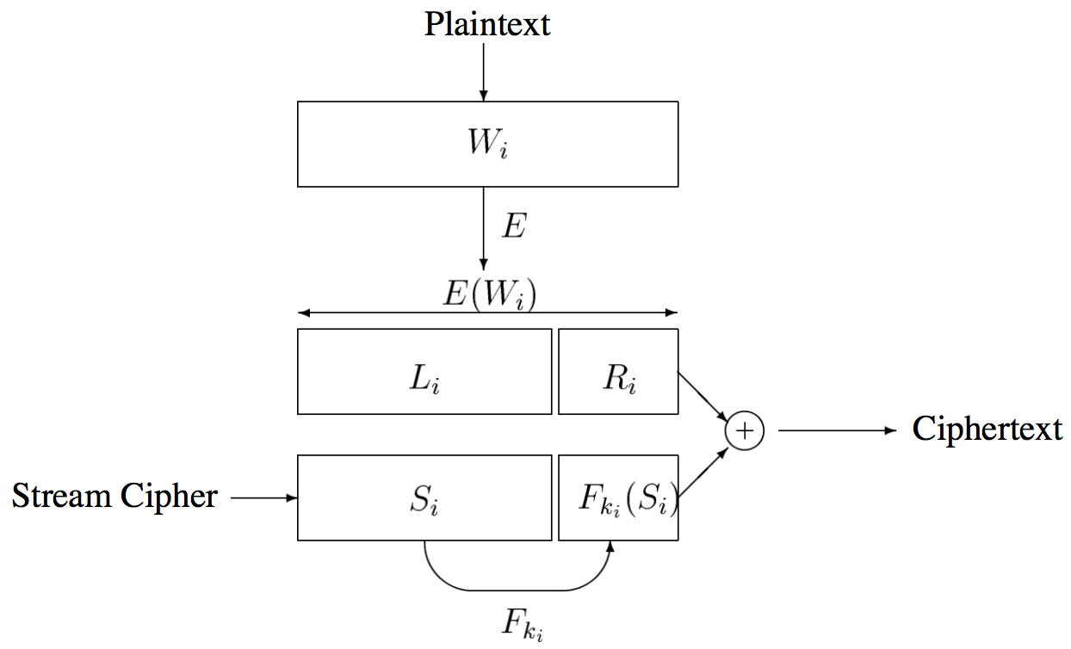
Scheme for Hidden Search
Notes:
One possibility is to use the same key k at every po- sition in the document. Another alternative is to choose a new key ki for each position independent of all other keys

Slide 20
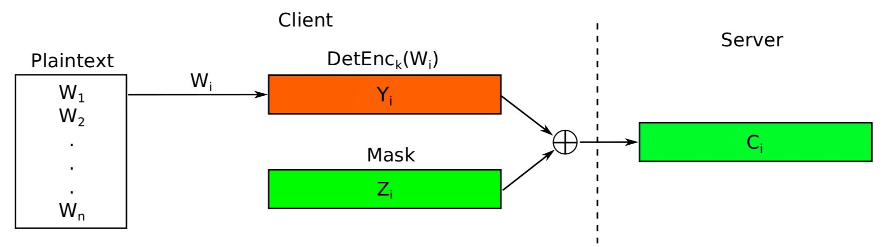
Scheme for Hidden Search
Notes:
One possibility is to use the same key k at every po- sition in the document. Another alternative is to choose a new key ki for each position independent of all other keys

Slide 21
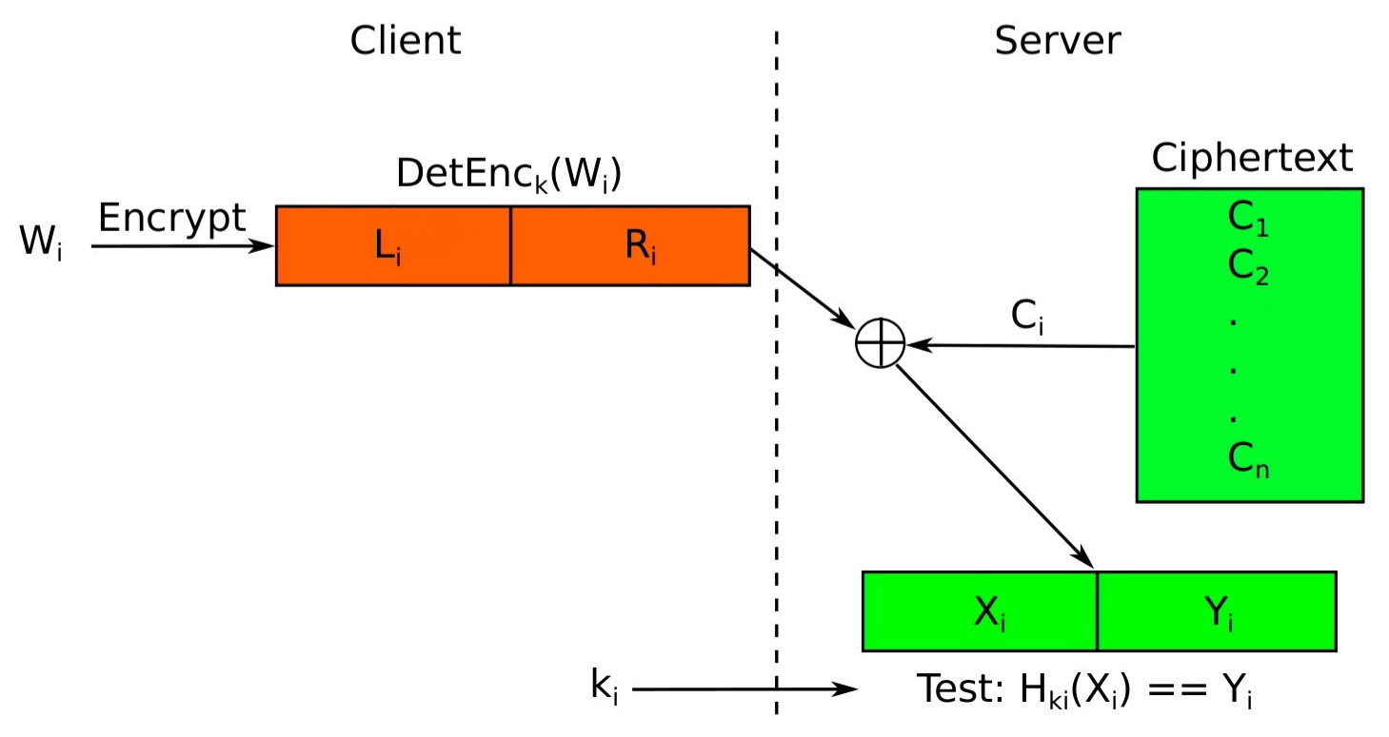
Search Using the Scheme for Hidden Search
To search for a word W , Alice computes X := E_{k’’} (W) and sends <X, k>to Bob.
This allows Bob to search for W without revealing W itself

Slide 22
Problems with this solution
Leaks the potential positions of the queried keywords in a document
After several queries, it is possible to learn the words inside the documents with statistical analysis
The complexity of the encryption and search algorithms is linear in the total number of words per document
Encryption: one encryption, one XOR, and two pseudo-random functions
Trapdoor: one encryption and a pseudo-random function
Search: one XOR and one pseudo-random function
=> Supports very slow search
For better efficiency, index-based approach can be adopted

Slide 23
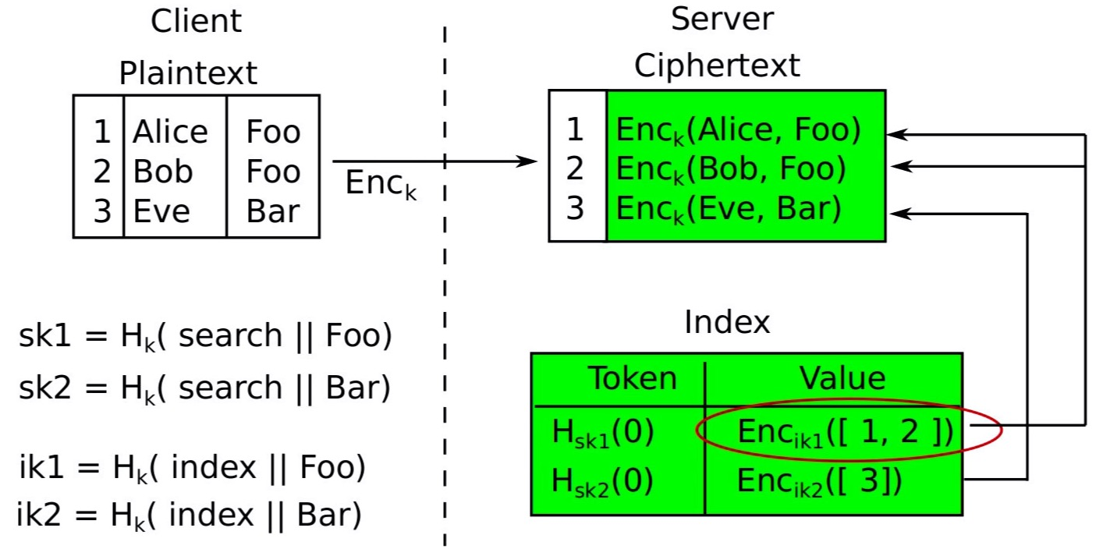
Index Based Preparation
Tokenize the data in a deterministic way (using hash)
New table or new columns are created when data is stored to keep the indexes
Notes:
When it comes to creating a value that corresponds to a piece of data that produces the same result every time, the first thing you should think of is not deterministic encryption but hash. We will create an index to search by hashing the data and saving it somewhere else (another column). This is called blind indexing.

Slide 24
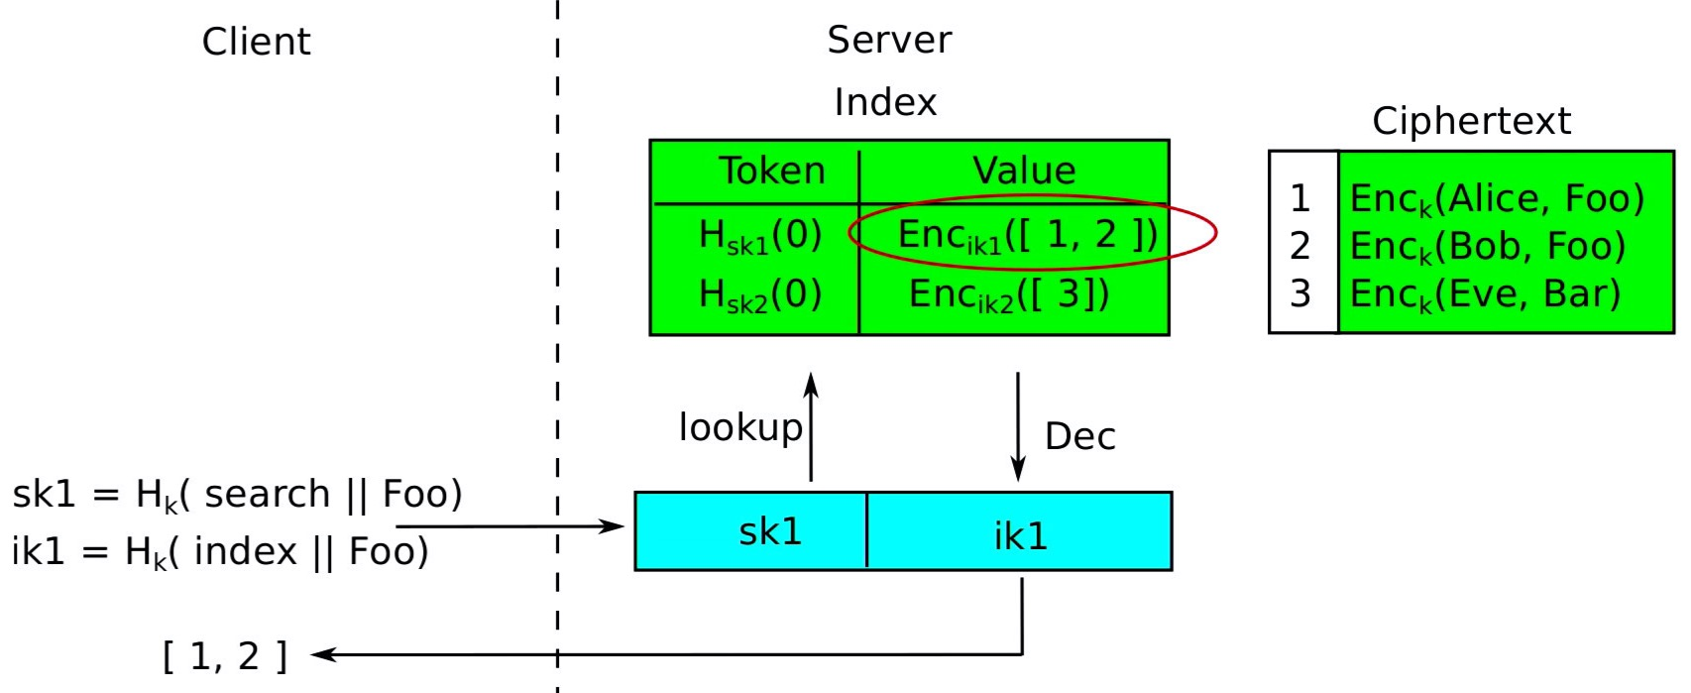
Search
Generate the keys for generating the token and the decrypting the value
Notes:
Client sends two values for search, one SK1 and other iK1

Slide 25
Order Preserving Encryption
(for numbers only)
A symmetric encryption scheme is order preserving if encryption maintains order relations ^{[Posani]}
Problems?

Slide 26
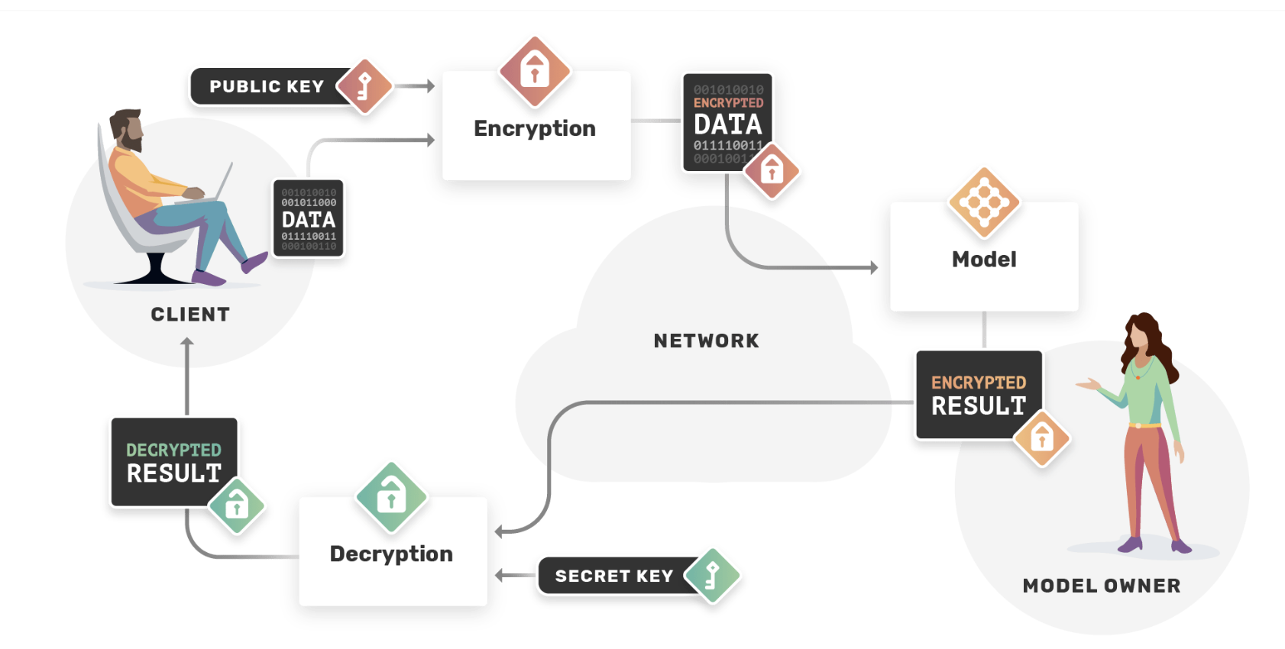
Encrypted Computations
Homomorphic Encryption Enables that!
Notes:
Wouldn’t it be nice to be able to...
Encrypt my data before sending it to the cloud
While still allowing the cloud to process them
Cloud returns encrypted answers
That I can decrypt

Slide 27
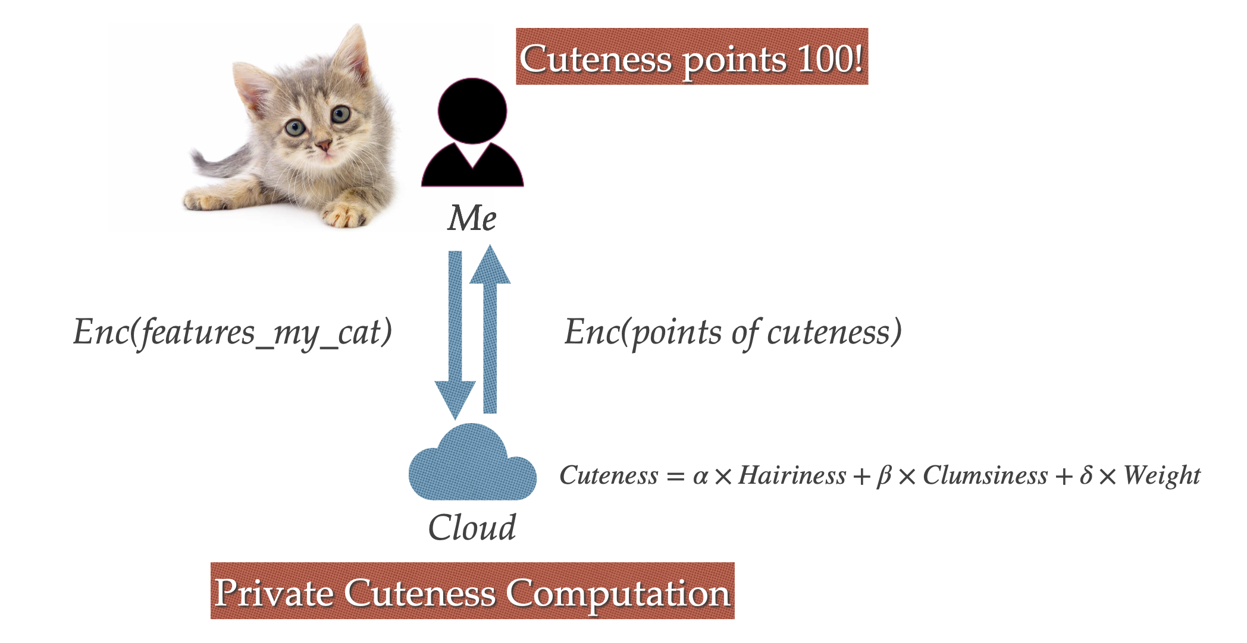
Encrypted Computations
Remote Server calculates the cuteness of the cat
without knowing what are the values for the features used to calculate the cuteness
without knowing the value of cuteness
Notes:
Server calculate the cuteness of yout without knowing what are the values for the features used to calculate the cuteness and without knowing the value of cuteness

Slide 28
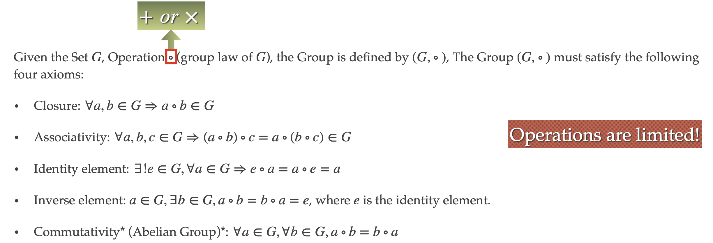
Homomorphism Group Definition
Notes:
A set of data and a group of operations
Real numbers
Following properties

Slide 29
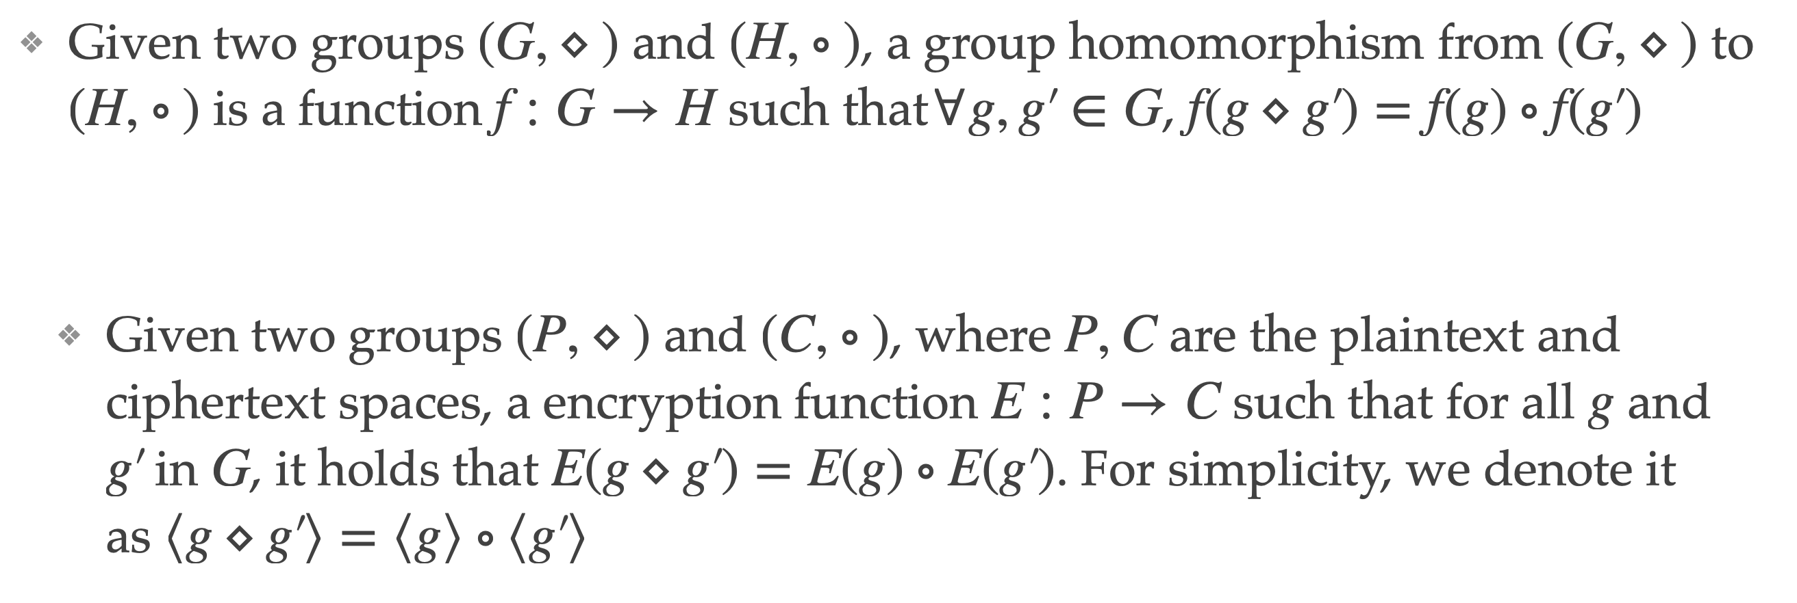
Homomorphism Group Definition

Slide 30
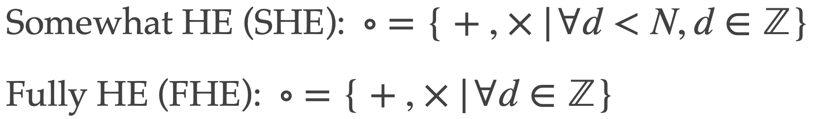
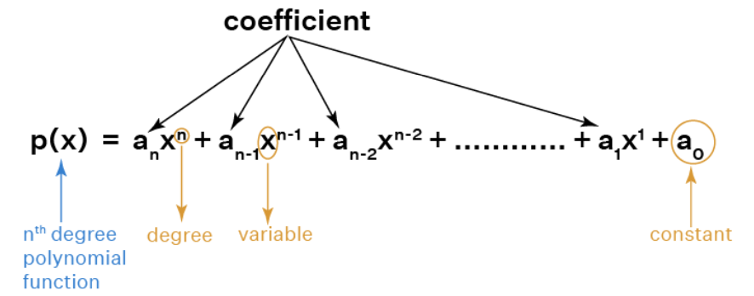
Categorization of HE Algorithm
allows certain mathematical operations (+ or x) and can be applied on a bounded number of operations
Additive Homomorphic Encryption
Multiplicative Homomorphic Encryption
allows both mathematical operations but on a bounded number of operations
allows both mathematical operations on an unbounded number of operations

Slide 31
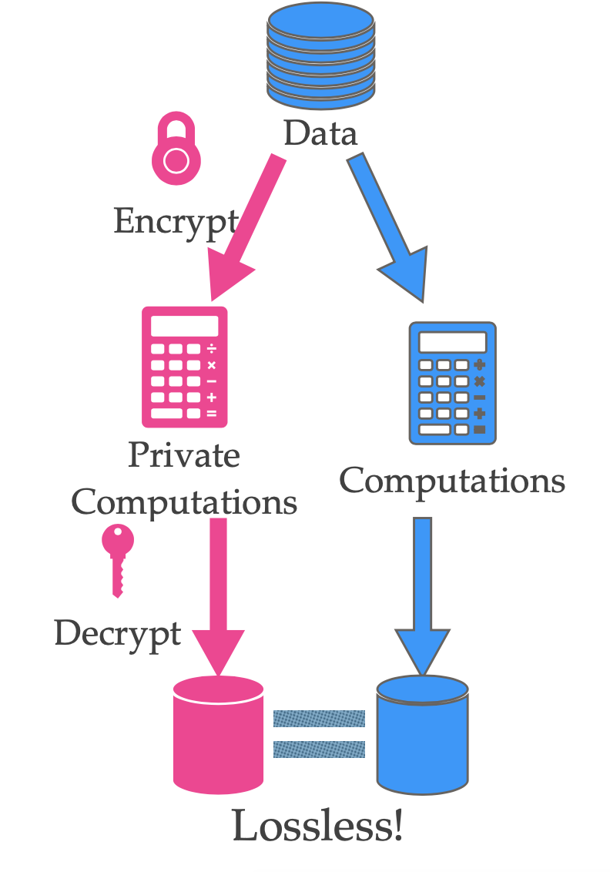
What is Homomorphic Encryption?
“Homomorphic encryption is a form of encryption that allows specific types of computations to be carried out on ciphertext and generate an encrypted result that, when decrypted, matches the result of operations performed on the plaintext.”
By Yi, X., Paulet, R., & Bertino, E. (2014).
The concept of homomorphic encryption was first introduced by Ronald L. Rivest and Len Alderman (The R and the A in RSA encryption)
Rivest, R. L., Adleman, L., & Dertouzos, M. L. (1978). On data banks and privacy homomorphisms. Foundations of secure computation, 4(11), 169–180.

Slide 32
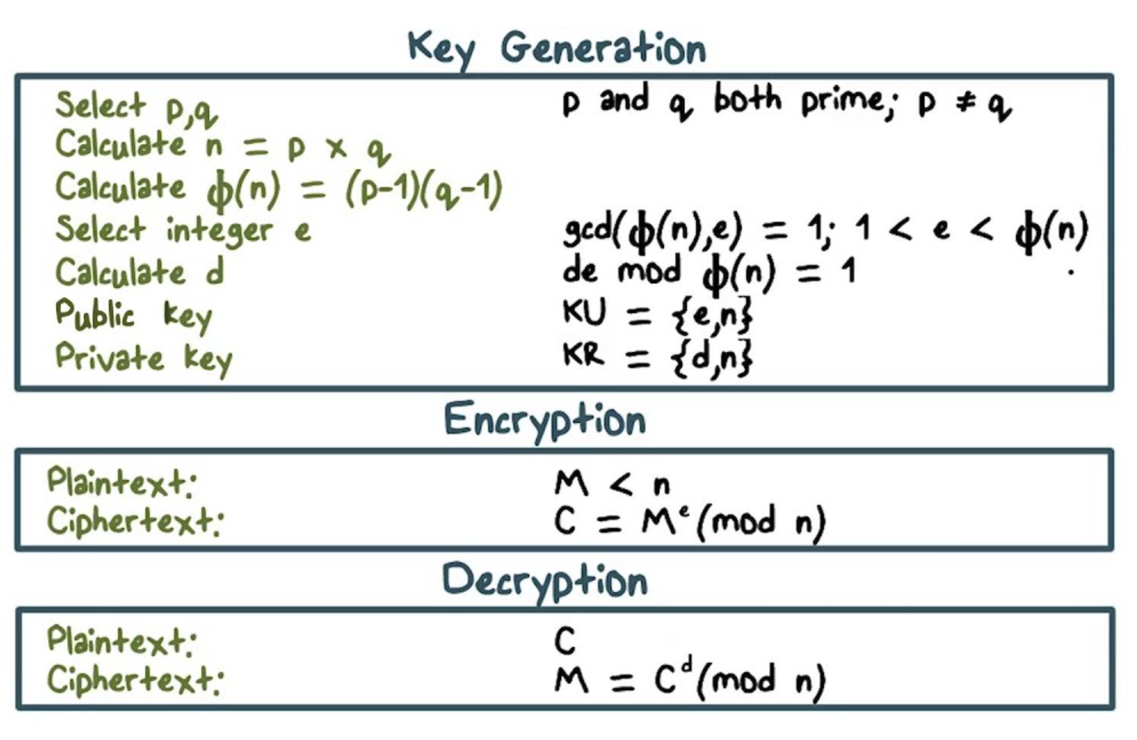
RSA Basics

Slide 33
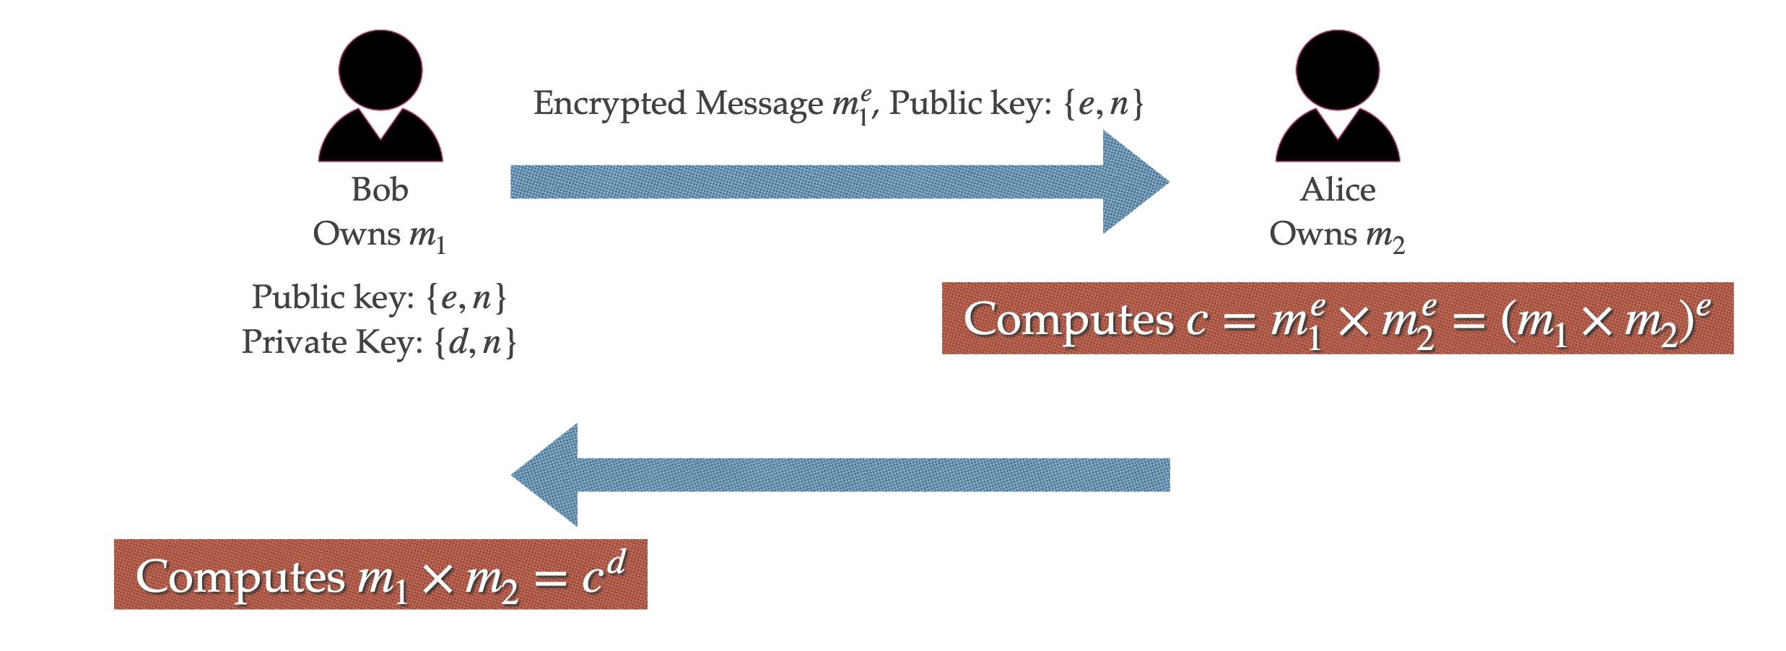
RSA Homomorphic Computation Scenario
The multiplication of encrypted m1 and m1 Is equal to encrypted multiplication of m1 and m2
Multiplicative Homomorphic

Slide 34
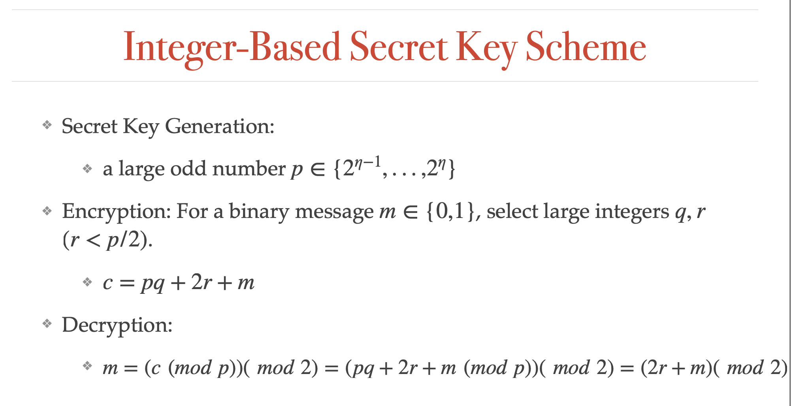
Both Additive and Multiplicative Homomorphic

Slide 35
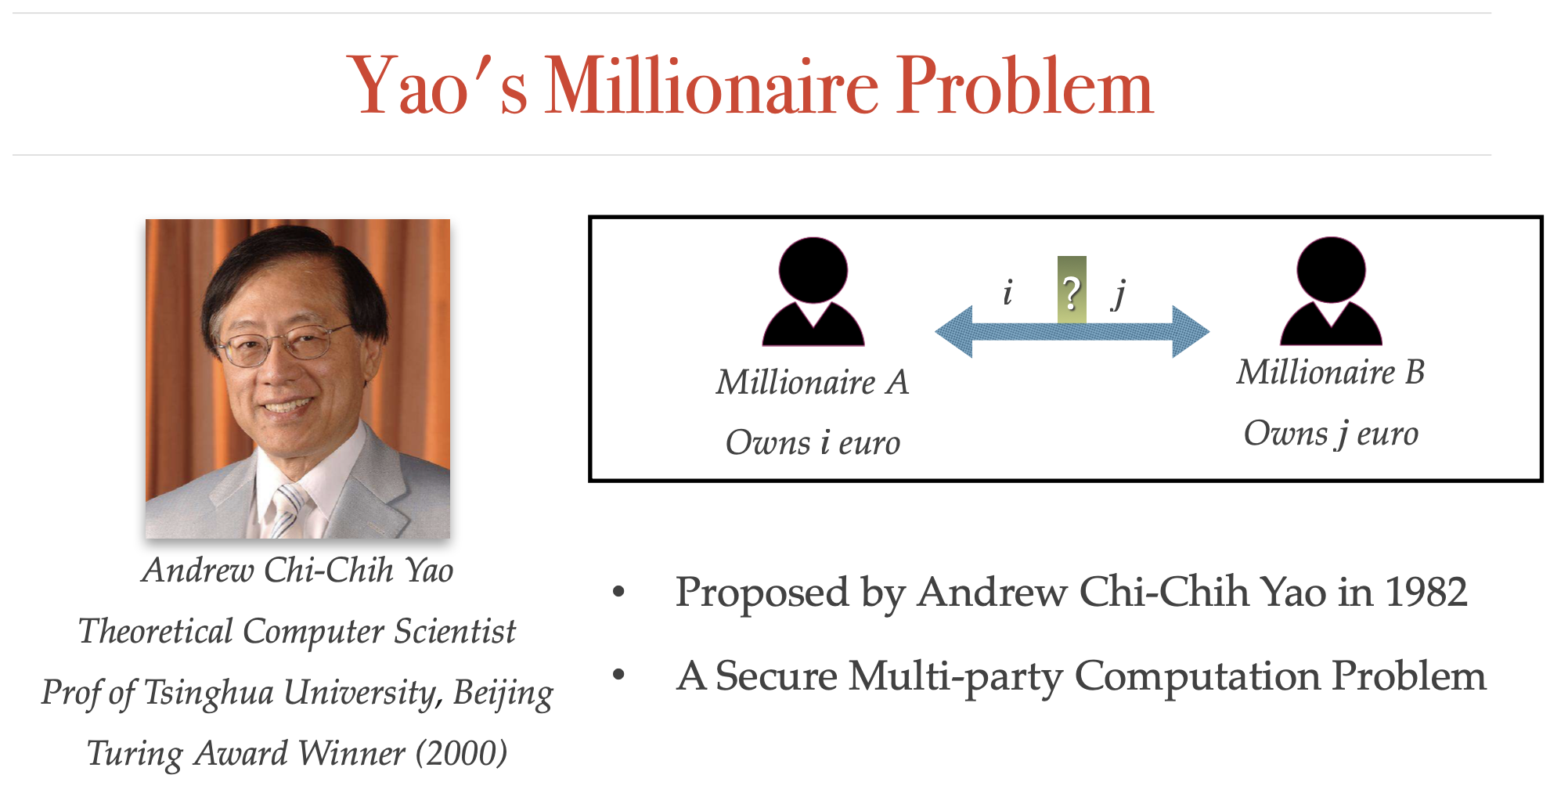

Slide 36
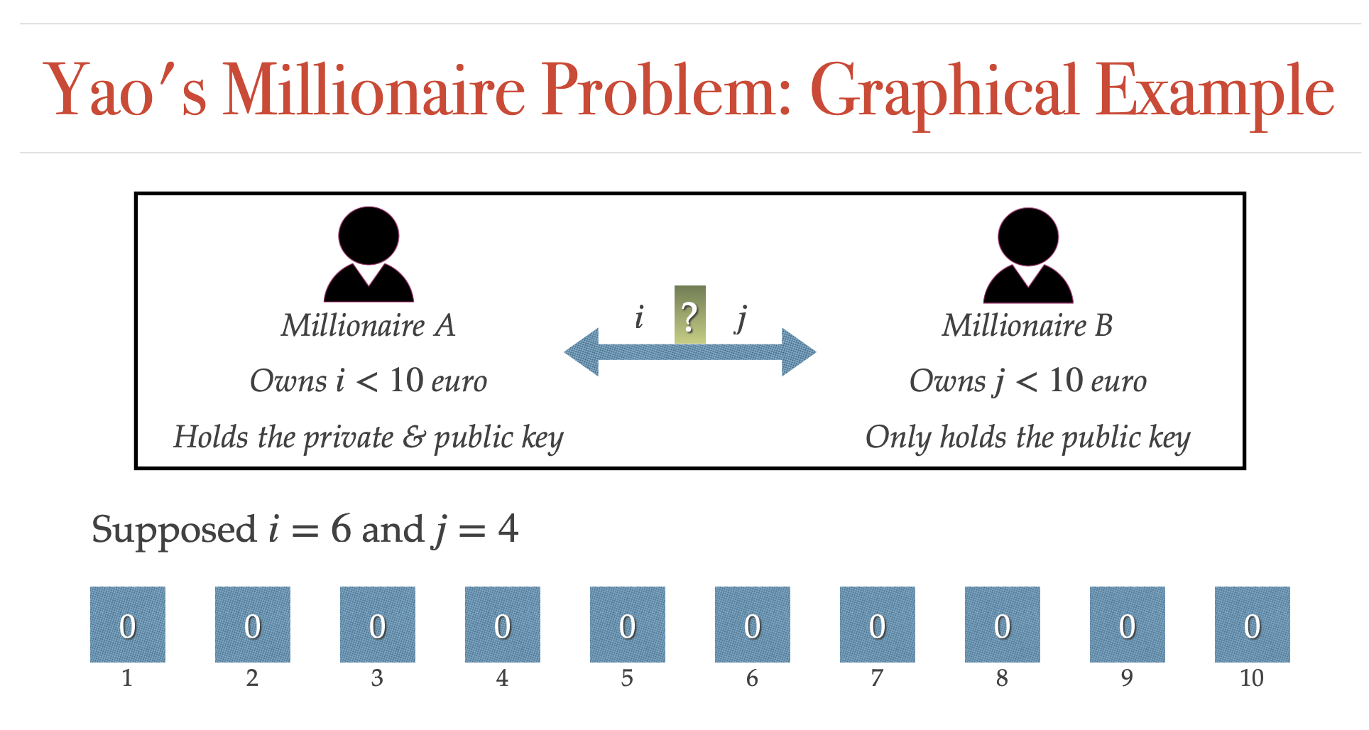

Slide 37
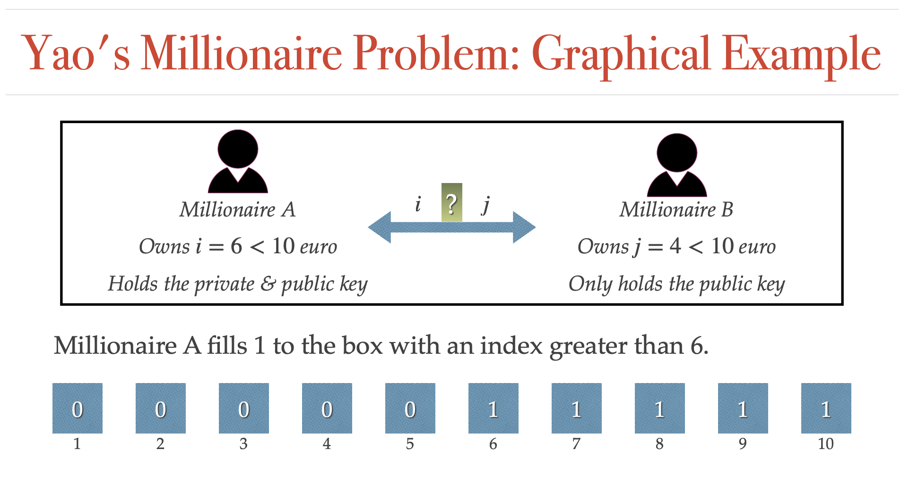

Slide 38
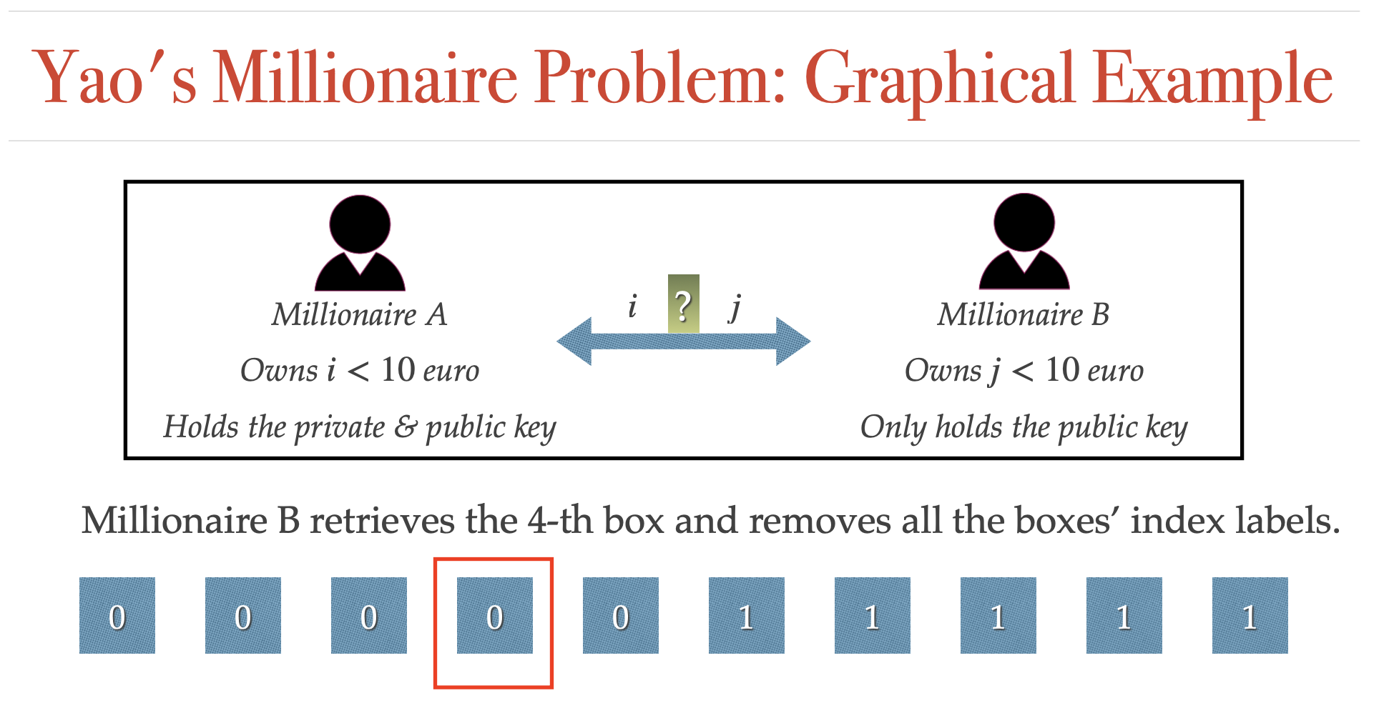

Slide 39
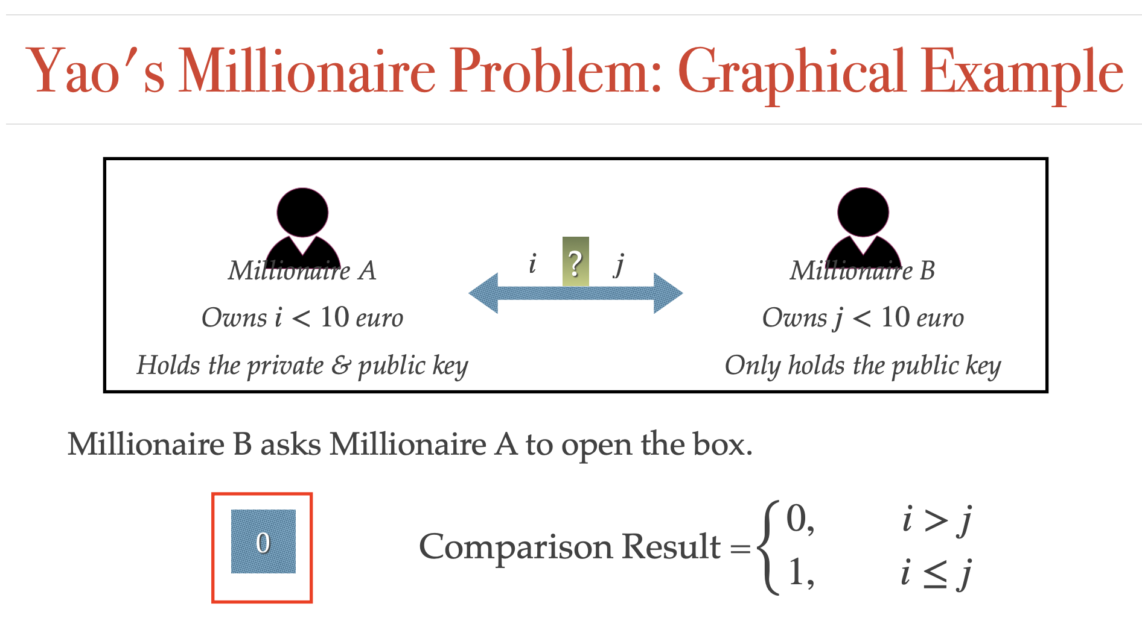
B opens the box

Slide 40
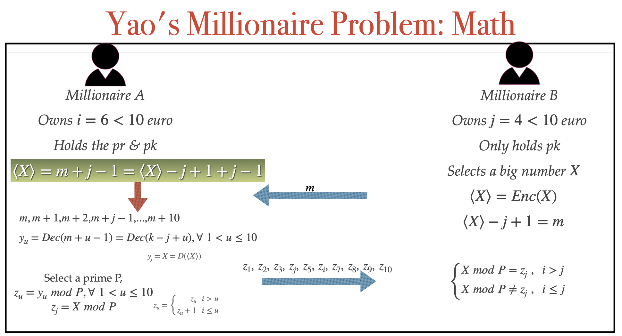
Calculate different possible X (y_{n})
p
Values are incremented for u >= 6

Slide 41
A Couple of Demos
https://github.com/atulmahind/song-wagner-perrig
SWP’00
https://pypi.org/project/pyope/
notebooks
https://github.com/jiangnan3/Searchable_Encryption
dev-searchable
https://github.com/encryptedsystems/Clusion
dev-java

Slide 42
Security and Privacy
Attacks to ML
Notes:
Hello everyone, today we are going to learn about how to search data without beaching Privacy.

Slide 43


Who cares about panda?
Classified as panda
Small adversarial noise
Classified as gibbon
Notes:
Gibbon is another animal

Slide 44

The Stop Sign attack
Notes:
In the left side we see some small changes on the sign. For us it is readable as stop but machine learning algorithm became confused

Slide 45
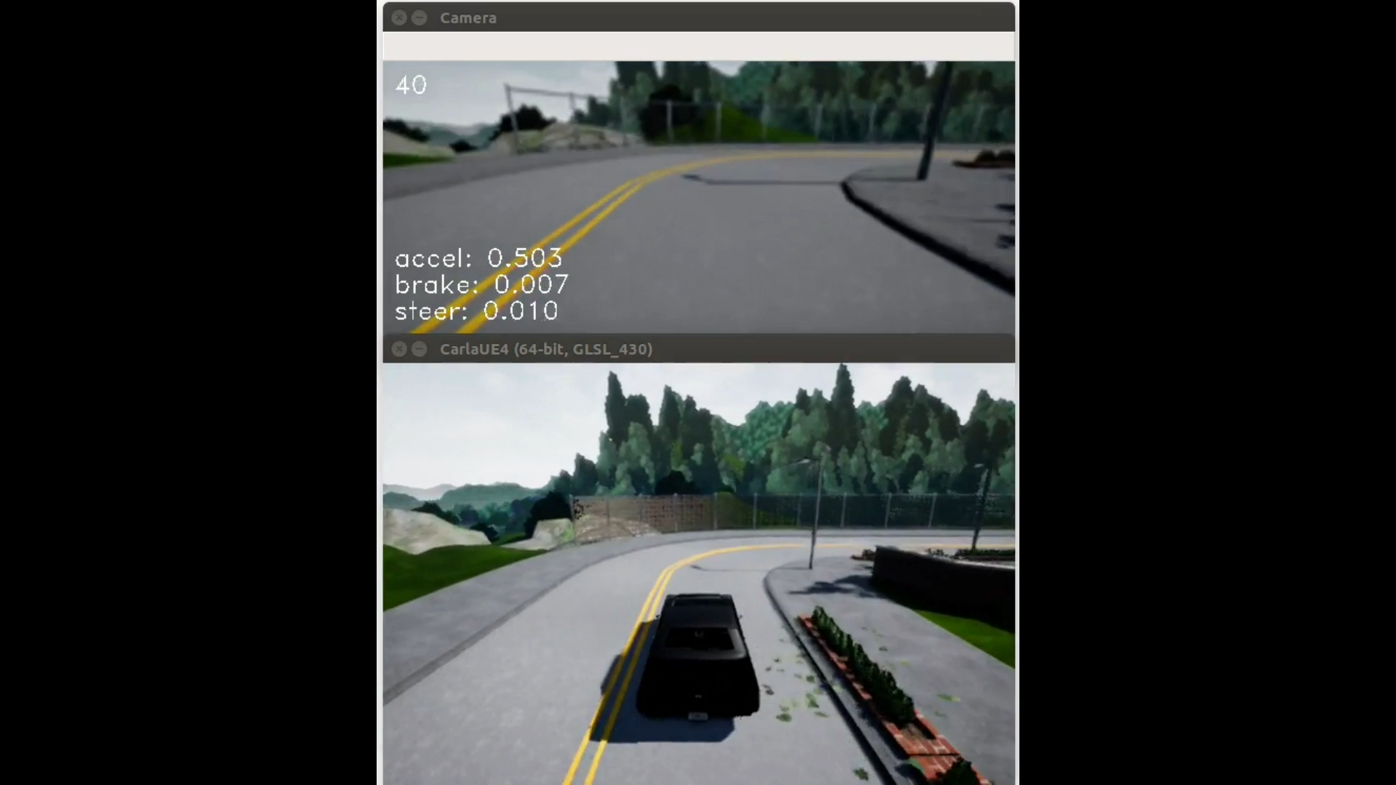
Attacking End-to-End Autonomous Car
No Attack
CNN for end-to-end autonomous driving

Slide 46

Attacking End-to-End Autonomous Car
Attack: add (paint) this object to the road (and rotate)

Slide 47

Attacking End-to-End Autonomous Car
No Attack
Under Attack

Slide 48
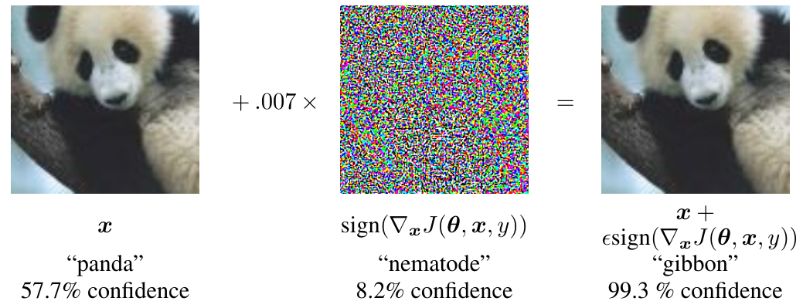
Adversarial Examples
Timeline:
“Adversarial Classification” Dalvi et al 2004: fool spam filter
“Evasion Attacks Against Machine Learning at Test Time” Biggio 2013: fool neural nets
Szegedy et al 2013: fool ImageNet classifiers imperceptibly
Goodfellow et al 2014: cheap, closed form attack

Slide 49




Turning Objects into “Airplanes”

Slide 50
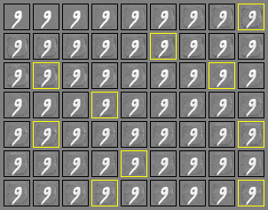
Attacking a Linear Model

Slide 51
Bad actors
Key issue in AML: bad actors (who do bad things) have objectives
not getting detected
perform malicious function
These “bad actors” will attempt to change the observed instances, their behavior, etc, to accomplish their goals
[Li2018]

Slide 52
Categorization of Attacks
The 3 dimensions of attacks on ML:
1. Attack timing | Decision-time vs. training time
2. Attacker information | White-box vs. black-box
3. Attacker goals | Targeted vs. reliability

Slide 53
Reliability Attacks
Maximize prediction error (largely in supervised learning)
Make learning unreliable
1. Attack timing | Decision-time vs. training time
2. Attacker information | White-box vs. black-box
3. Attacker goals | Targeted vs. reliability

Slide 54
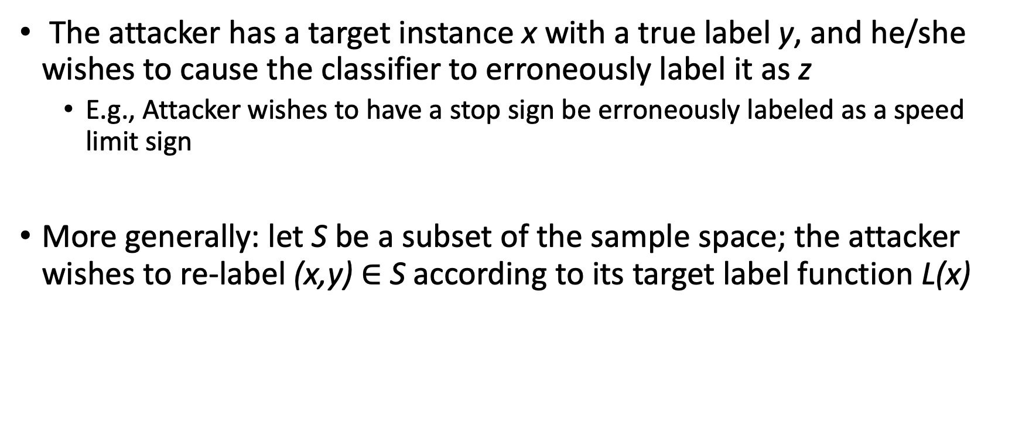
Targeted Attacks
The attacker has a target instance x with a true label y, and he/she wishes to cause the classifier to erroneously label it as z
E.g., Attacker wishes to have a stop sign be erroneously labeled as a speed limit sign
More generally: let S be a subset of the sample space; the attacker wishes to re-label (x,y) $∈$ S according to its target label function L(x)
1. Attack timing | Decision-time vs. training time
2. Attacker information | White-box vs. black-box
3. Attacker goals | Targeted vs. reliability

Slide 55
White-Box Attacks
Attacker knows everything they need to know about the system
Example: in Decision-time attacks, the attacker knows the model f (including the features)
Equivalently, the attacker knows features, algorithm (including hyperparameters), and has the same dataset
Can then learn the model f
1. Attack timing | Decision-time vs. training time
2. Attacker information | White-box vs. black-box
3. Attacker goals | Targeted vs. reliability

Slide 56
Black-Box Attacks
Any limitation on information to the attacker
Doesn’t know the model, or the algorithm, or the features, exactly; typically has some information about these
1. Attack timing | Decision-time vs. training time
2. Attacker information | White-box vs. black-box
3. Attacker goals | Targeted vs. reliability

Slide 57

Decision-Time Attacks
Attacker attacks the model, **not the algorithm**
original input
Model f
Classified as panda
attack
Classified as gibbon
adversarial noise

Slide 58

Training-time Attack (Poisoning attack)
Raw Data
Malicious Manipulation
Poisoned Raw Data
Features
Processed Data
Learning Algorithm
Model f
Notes:
training time

Slide 59
Attacks on machine learning (ML) models that can breach privacy
Model inversion: an adversary tries to reconstruct sensitive training data by observing the output of a trained ML model
By querying the model with carefully crafted input, the attacker can learn information about the training data that was used to create the model.
Membership inference: This attack aims to determine whether a specific data point was part of the training dataset used to train the ML model.
By observing the output of the model for different inputs, an attacker can infer membership information

Slide 60
Classification learning
Class 1
classifier
Class 2
Data set: {(x₁,y₁),…,(x_{n},y_{n})}, (x,y) ~ D
x: feature vectors
y: binary label in {-1, +1} representing which class x belongs to
Learning: train classifier f(x) on data
Prediction: use f(x) to predict label for arbitrary x

Slide 61
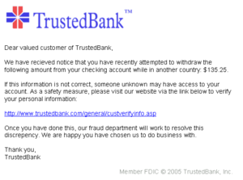
Classification in adversarial settings
Often, classifiers are tasked with telling apart ”good” from “bad”
Spam vs. non-spam (ham)
Benign vs. malicious software
Intrusion detection

Slide 62
Evasion attacks
Adversary who previously chose instance x (which is now classified as malicious) now chooses another instance x’ which is classified as benign

Slide 63
Evasion attacks
Adversary who previously chose instance x (which is now classified as malicious) now chooses another instance x’ which is classified as benign
Benign
Malicious

Slide 64
Evasion attacks
Adversary who previously chose instance x (which is now classified as malicious) now chooses another instance x’ which is classified as benign
Benign
classifier
Malicious

Slide 65
Example of Evasion
From: spammer@example.com
Cheap mortgage now!!!
1.
Feature Weights
2.
cheap = 1.0
mortgage = 1.5
3.
Total score = 2.5
> 1.0 (threshold)
Spam
Notes:
Evasion attack example!!
Bag of words

Slide 66
Example of Evasion
From: spammer@example.com
Cheap mortgage now!!! Joy Oregon
1.
Feature Weights
2.
cheap = 1.0
mortgage = 1.5
Joy= -1.0
Oregon = -1.0
3.
Total score = 0.5
< 1.0 (threshold)
OK

Slide 67
Other quality Attributes
Fairness
Tansparency
Accountability
https://fairlearn.github.io/
http://dsapp.uchicago.edu/aequitas/
[Valentim19]

Slide 68
Fairness Concepts
Fairness is difficult to define due to its ambiguity and subjectivity
Absence of bias or discrimination against people based on protected or sensitive attributes.
Direct discrimination vs. Indirect discrimination
Disparate treatment vs. Disparate impact
Individual fairness
Materialization through conditions and metrics
Notes:
Embora seja difícil definir fairness pela sua ambiguidade e subjectividade, ao longo do trabalho consideramos que um sistema é fair na ausência de discriminação com base em atributos protegidos ou sensíveis, como a raça, o sexo ou a idade. A discriminação com base nestes atributos é geralmente proibida por lei.
A discriminação em sistemas inteligentes pode ter várias origens e assumir diversas formas. Os dados utilizados para treinar os modelos podem desde logo apresentar unfairness, devido a amostragens injustas ou à atribuição de classes como resultado de decisões que não são imparciais. Mesmo que o treino se baseie em dados históricos que apresentem discriminação, esta não deve passar para as classificações feitas pelos modelos.
A discriminação directa, também chamada tratamento díspar, resulta da utilização explícita de atributos sensíveis na tomada de decisões: por exemplo, a idade pode ser um dos atributos de um dataset e as classificações de um modelo treinado com estes dados podem prejudicar indivíduos mais jovens.
Quando as decisões tomadas se baseiam numa disposição, critério ou prática aparentemente neutro, mas indivíduos de determinados grupos sociais são, ainda assim, colocados em desvantagem comparativamente com outras pessoas estamos na presença de discriminação indirecta. Este tipo de discriminação está directamente ligado a impacto díspar e esta definição é encontrada na legislação de diversos países, como é o caso do Código de Trabalho de Portugal.
All these fairness notions focus on fairness at a group-level, where we look at an individual as being part of a socio-economic group.
On the other hand, we have the notion of individual fairness which defends that similar individuals should be given a similar treatment. The difficulty here is in defining the similarity between individuals.
It is also important to notice that, since fairness is quite subjective, fairness only materializes itself through the definition of conditions and metrics.

Slide 69

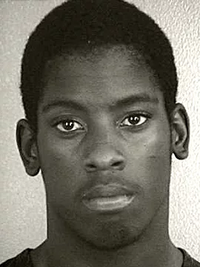
Real-World Example - COMPAS
African-Americans were mistakenly labelled as potential recidivists at an higher rate than Caucasians
Prior Offenses 1 domestic violence aggravated assault 1 grand theft 1 petty theft 1 drug trafficking Subsequent Offenses 1 grand theft | Prior Offenses 1 petty theft Subsequent Offenses None
LOW RISK – 3 | MEDIUM RISK – 6
[Valentim19]

Slide 70
References
[Goodfellow16] Ian Goodfellow, Staff Research Scientist, Google Brain, CS 231n, Stanford University, 2017-05-30.
[Li2018] Bo Li, Dawn Song, Yevgeniy Vorobeychik, “Adversarial Machine Learning Tutorial”, https://aaai19adversarial.github.io/index.html#over
[Valentim19] Inês Valentim et al, The Impact of Data Preparation on the Fairness of Software Systems, ISSRE 2019

Slide 71
Security and Privacy
Synthetic Data Generation
Notes:
Now that we learned it is even possible to somehow learn about the data through the machine learning models, maybe sometimes it is helpful to generate synthetic data for building the models.

Slide 72
Why Synthetic Data?
Synthetic data generation
Techniques
Evaluation
Products
Practical Example

Slide 73
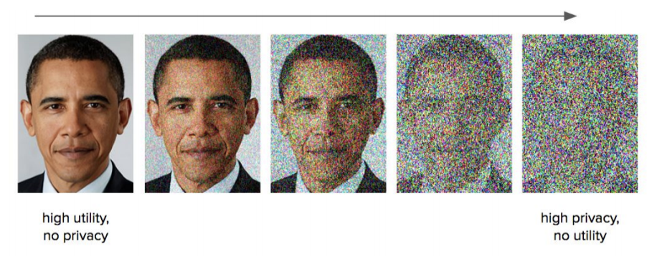
Anonymization is Hard …
Course of high dimensionality
Private vs utility tradeoff
Assumptions about Attackers

Slide 74
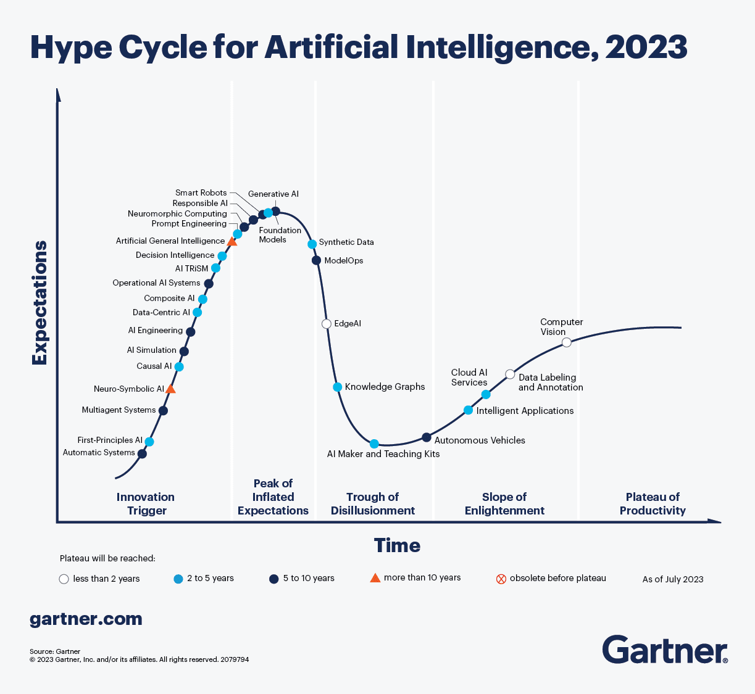
Notes:
https://www.kdnuggets.com/gartner-hype-cycle-for-ai-in-2023

Slide 75
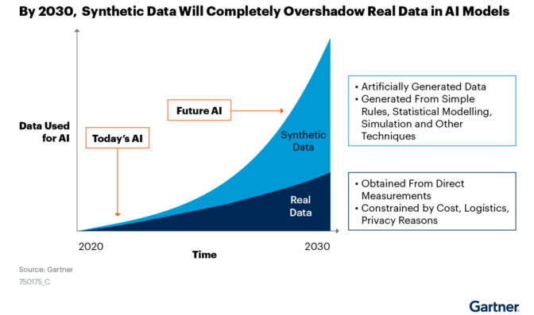
Notes:
https://blogs.nvidia.com/blog/2021/06/08/what-is-synthetic-data/

Slide 76
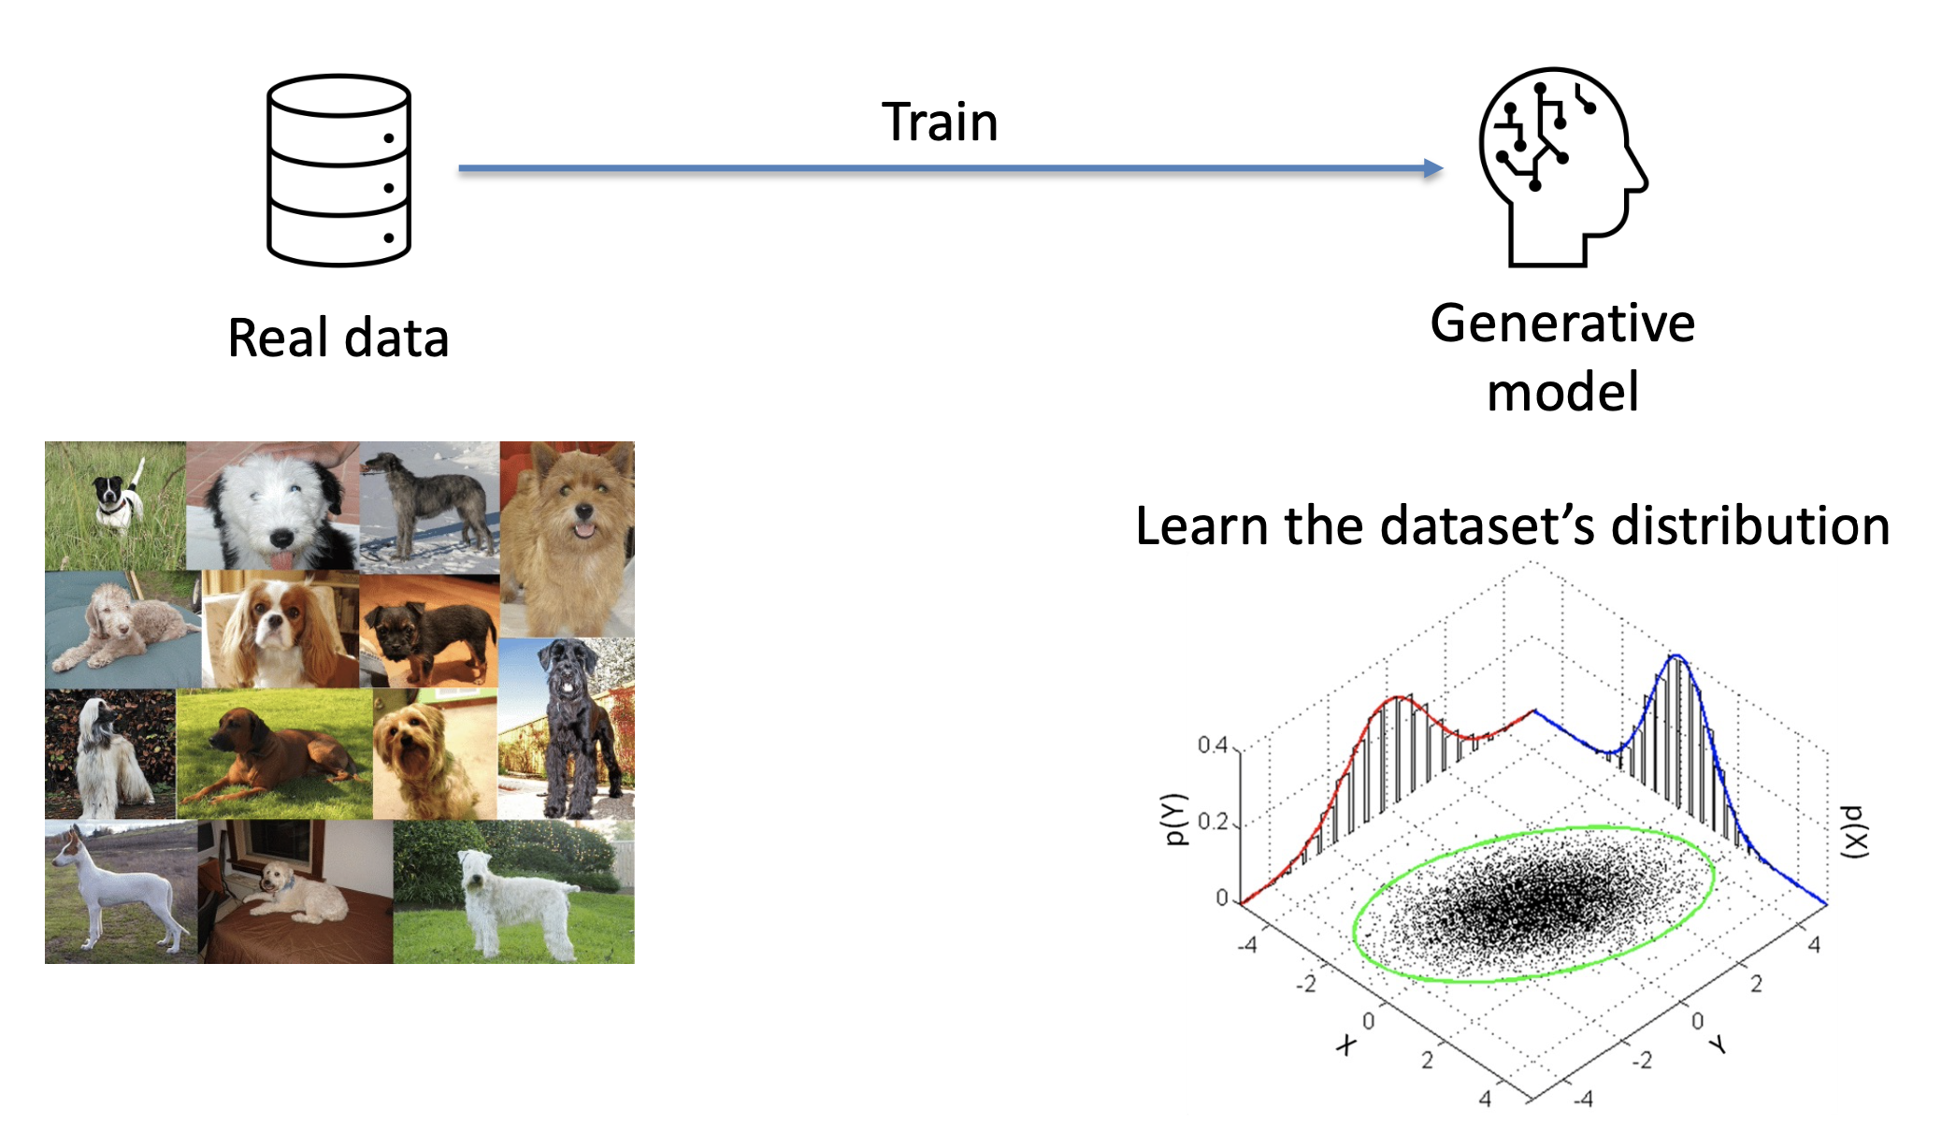

Slide 77
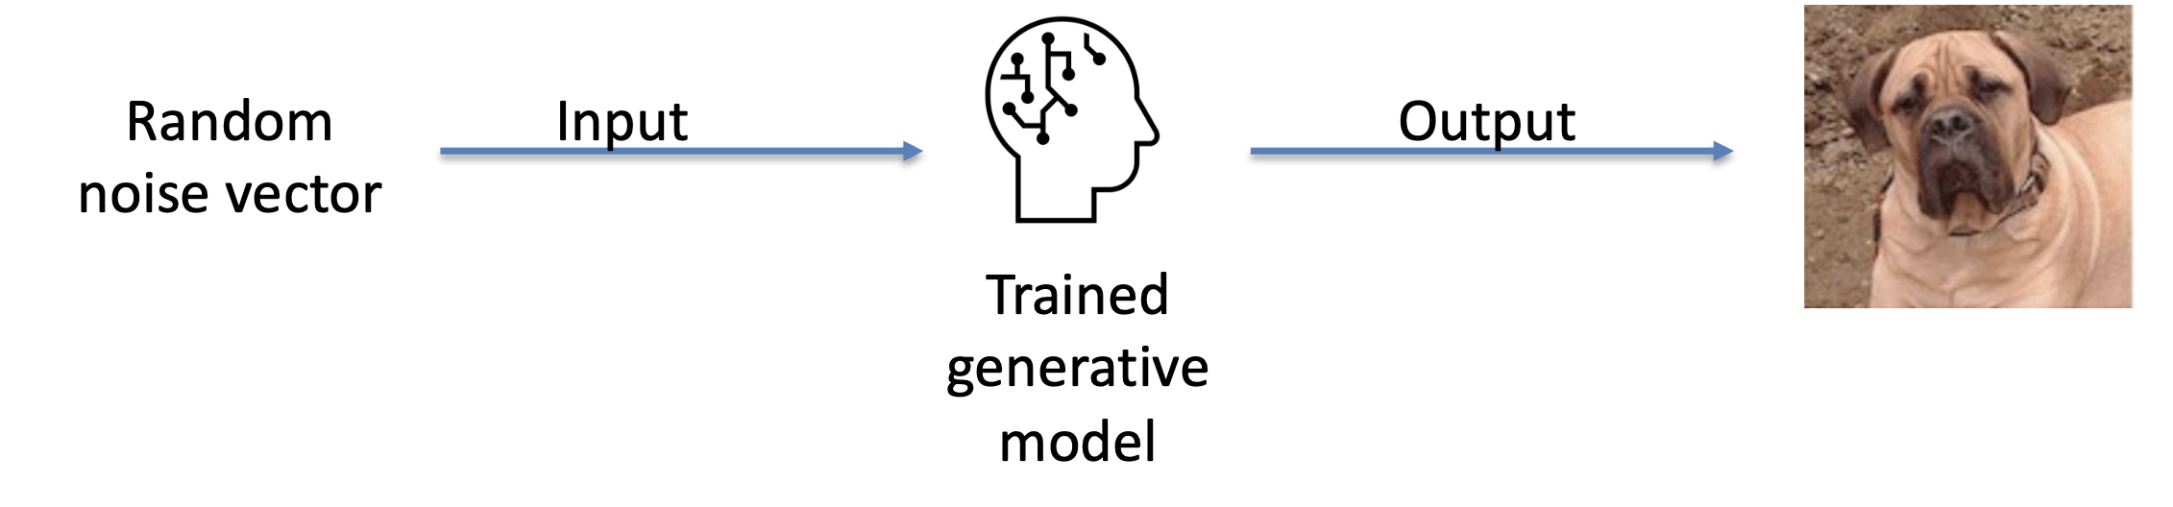

Slide 78


Is Synthetic Data Generation any Good?
Notes:
These pictures do not belong to any real human being, these are generated by AI

Slide 79
Synthetic Data Types
Tabular Data
Typically, more privacy-sensitive
Image Data
Recent Success (e.g., NVIDIA’s styleGAN)
Text data
Recent Success (e.g., ChatGPT)
Relational Data
Multiple related tables
Several challenges

Slide 80
Advantages of Synthetic Data
Unlimited data
Data Augmentation
Data Quality
Real world data is messy
Lots of errors and inconsistencies
Privacy
Is it?
Similarity Checks
Notes:
Unlimited data
Data Augmentation
Data Quality
Real world data is messy
Lots of errors and inconsistencies
Privacy
Is it?
Outlier removal
Similarity Checks

Slide 81
Synthetic data Use cases
Testing
Unlimited data for testing
Software development
AI model testing
AI/ML
Data Augmentation
Generation of rare events/patterns
Imbalanced data
Compliance with Privacy Regulations

Slide 82
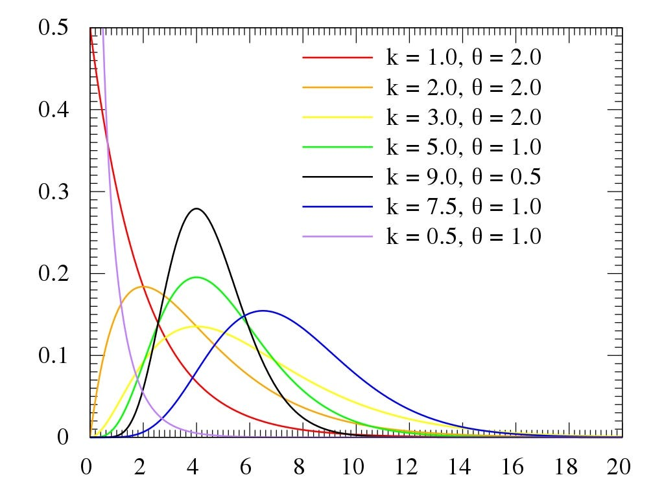
Synthetic Tabular data generation techniques
Distribution Fitting
For more simple cases/scenarios
Where synthetic data quality is not so relevant
If no real data is available
Draw random numbers from a known distribution
If real data is available
Fit a distribution to the real data
Sample from distribution

Slide 83
Synthetic Tabular data generation techniques
Deep learning
Use deep learning models to learn the distribution of the training data and use it to sample new data from that distribution
Comparing to distribution fitting:
High Computation cost, complexity
High data quality
Algorithms
Variational AutoEncoders (AVE)
Generative Adversarial Networks (GAN)

Slide 84
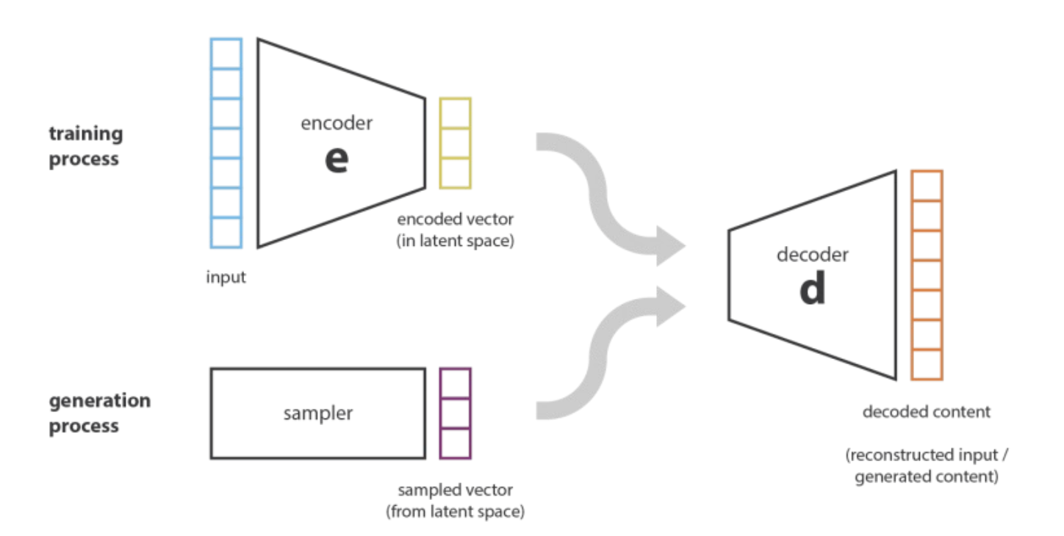
Deep Learning – AVE
Encoder (e) compresses input into a lower-dimension space (latent space)
Decoder (d) attempts to re-generate the input vector from the encoded vector
After training, a random sampled vector from the latent space inputed to the decoder results in a synthetic data point

Slide 85
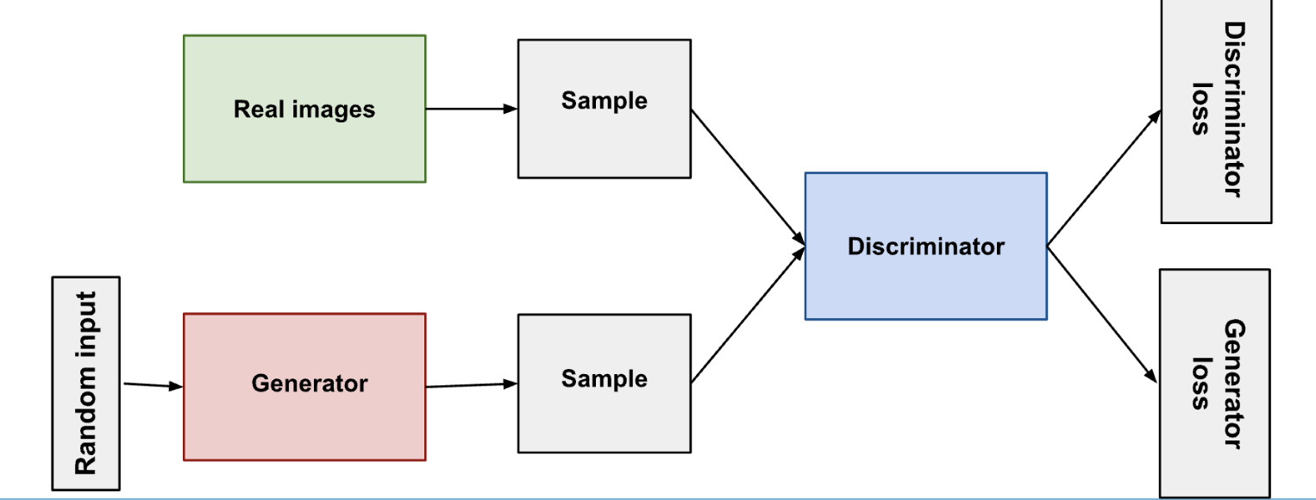
Deep learning- GAN
§ The generator learns to generate plausible data. The generated instances become negative training examples for the discriminator.
§ The discriminator learns to distinguish the generator's fake data from real data. The discriminator penalizes the generator for producing implausible results.
§ After training, the generator is fed a random input sample and outputs a synthetic data point.

Slide 86
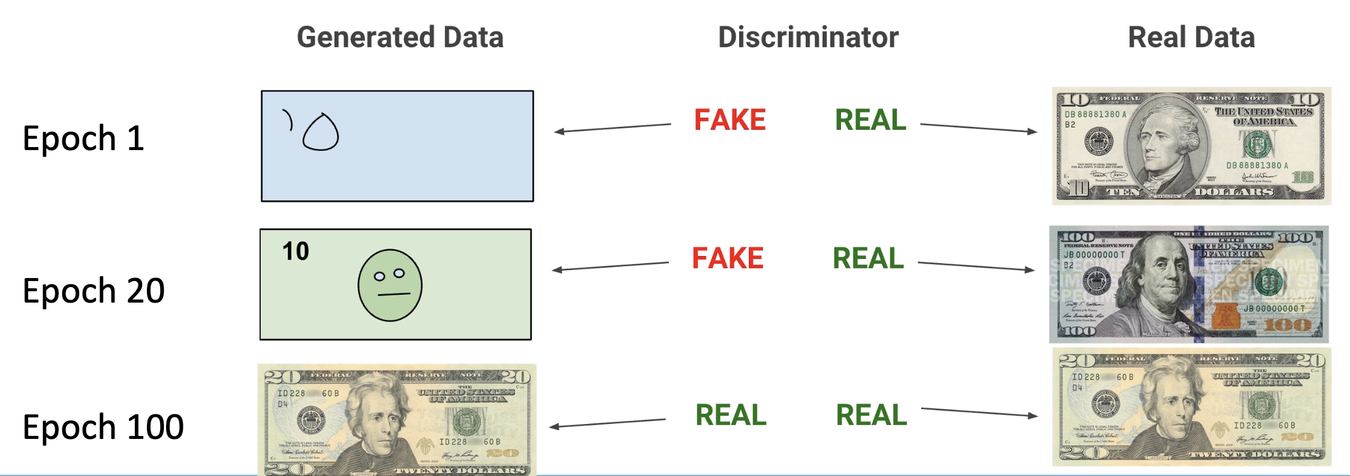

Slide 87
Security and Privacy
Ethics and Regulations
Notes:
Now that we learned it is even possible to somehow learn about the data through the machine learning models, maybe sometimes it is helpful to generate synthetic data for building the models.

Slide 88
To remember …
Privacy
There are things that other people should not see or know (Elgesem, 1996)
It is a human right, but it is not absolute when or to what extent privacy is preserved
“Computers did not invent privacy issues”
Computers systems’ processing, storage and transmission capabilities cause major challenges to privacy

Slide 89

Privacy vs Public Safety…

Slide 90

Privacy vs Social Communication
Notes:
leaked highly classified information from the National Security Agency in 2013

Slide 91
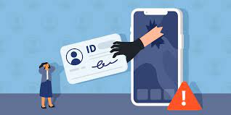
Identity Theft
Taking or assuming another person’s identity
Affecting 1 in 20 consumers today
Consequence of lack of privacy

Slide 92
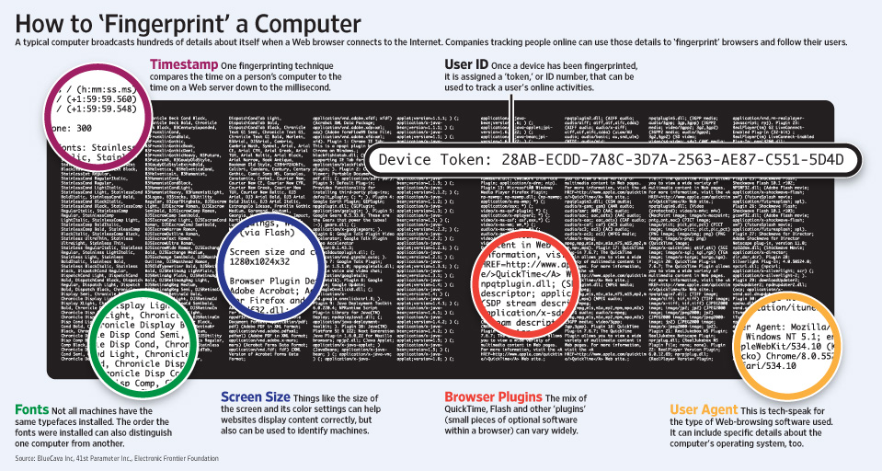
Privacy on the Web
An advantage of the Internet is (was?) anonymity
Also a disadvantage …
Cookies, adware, spybots, and malicious code have limited anonymity
Device fingerprinting

Slide 93
Privacy on the Web
An advantage of the Internet is (was?) anonymity
Also a disadvantage …
Cookies, adware, spybots, and malicious code have limited anonymity
Device fingerprinting
[Pfleeger]

Slide 94

Two fundamental rights
Privacy
“Right to be left alone”
Art. 8 ECHR (1950):
“Everyone has the right to respect for his or her private and family life, home and correspondence “
Article 7 EU-Charter (2000): “and communications…”
Data protection
Article 8 EU-Charter
Article 16 TFEU
“Everyone has the right to the protection of personal data concerning him or her.”
“self-determination”

Slide 95
2009: Treaty of Lisbon
Everyone has the right to the protection of personal data concerning them
Data protection principles
Art. 16 TFEU
EP + Council shall lay down the rules on processing of personal data by EU administration + Member States for activities under Union law, and the rules relating to the free movement of such data.
Compliance with these rules shall be subject to the control of independent authorities.
Notes:
Already pre-Lisbon: Reg. 45/2001, now, post-Lisbon, new legal basis (outlook).

Slide 96
Some basic rules…
Such data must be processed fairly for specified purposes and on the basis of the consent of the person concerned or some other legitimate basis laid down by law.
Everyone has the right of access to data which has been collected concerning him or her, and the right to have it rectified.
3. Compliance with these rules shall be subject to control by an independent authority
Notes:
96
96

Slide 97
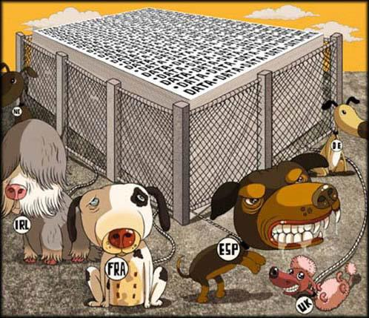
Supervision: who controls the controllers?
Notes:
Cooperation in particular in WP29.
Article 29 Working Party (cooperation with Member states’ DPAs to discuss common interpretation of data protection legislation and give expert advice to the European Commission)
Shared supervision with Member States’ DPAs of large scale IT systems (Eurodac, SIS II, VIS, CIS, IMI)
2 major data protection conferences:
European (DPAs and Council of Europe)
International (worldwide DPAs)

Slide 98
Supervision: who controls the controllers?
Art. 28 Directive 95/46: MS must provide for independent Data Protection Authorities (DPAs) to monitor and enforce application of national law implementing Directive 95/46;
Every data subject can lodge complaints with the DPAs, DPAs can go to court;
EDPS monitors and ensures compliance with Regulation 45/2001 by EU institutions and bodies.
Art. 41(2), 44, 46 Reg. 45/2001

Slide 99

The EDPS

Slide 100
U.S. Privacy Laws
1974 Privacy Act (5 USC 552a)
Most of these principles, only to data collected and maintained by the U.S. government
Other organizations have individual laws
Consumer credit: Fair Credit Reporting Act
Healthcare info: Health Insurance Portability and Accountability Act (HIPAA)
Separate laws are inconsistent in protecting privacy
To make matters worse, many laws vary by municipality and state…
e-Government Act of 2002
requires federal government agencies to post privacy policies on their websites

Slide 101
EU Privacy Laws
Privacy Directive 95/46/EC
Rights of privacy of individuals must be maintained and that data about should be:
Processed fairly and lawfully.
Collected for specified, explicit, and legitimate purposes
Adequate, relevant, and not excessive
Accurate and, where necessary, kept up to date
Permits identification of subjects for minimum time
Special protection for sensitive data; Data transfer; Independent oversight
Data Protection Act 1998 in UK
Replaced by GDPR!
Notes:
European Privacy Directive, requires that rights of privacy of individuals be maintained and that data about them be
• processed fairly and lawfully.
• collected for specified, explicit, and legitimate purposes and not further processed in a way incompatible with those purposes (unless appropriate safeguards protect privacy).
• adequate, relevant, and not excessive in relation to the purposes for which they are collected or further processed.
• accurate and, where necessary, kept up to date. Indeed, where data are found to be inaccurate or incomplete, every reasonable step must be taken to ensure that the data are erased or rectified, with respect to the purposes for which they were collected or for which they are further processed.
• kept in a form that permits identification of data subjects for no longer than is necessary for the purposes for which the data were collected or for which they are further processed.
• Special protection for sensitive data. There should be greater restrictions on data collection and processing that involves “sensitive data.” Under the E.U. data protection directive, information is sensitive if it involves “racial or ethnic origin, political opinions, religious beliefs, philosophical or ethical persuasion ... [or] health or sexual life.”
• Data transfer. This principle explicitly restricts authorized users of personal information from transferring that information to third parties without the permission of the data subject.
• Independent oversight. Entities that process personal data should not only be accountable but should also be subject to independent oversight. In the case of the government, this principle requires oversight by an office or department that is separate and independent from the unit engaged in processing the data. Under the data protection directive, the independent overseer must have the authority to audit data processing systems, investigate complaints brought by individuals, and enforce sanctions for noncompliance.

Slide 102
The General Data Protection Regulation (GDPR) https://gdpr-info.eu/

Slide 103
What is the GDPR?
At the end of 2015, the European Parliament and Council agreed a final draft of the General Data Protection Regulation to be applied in the UK from 2018.
Rules
Protection of fundamental rights and freedoms
In particular, protection of right to the protection of personal data.
Aims:
Improve general levels of privacy for individuals

Slide 104
The GDPR - new and changed concepts from the Data Protection Act 1998
Transparency and consent issues – information to be provided to individuals, and permissions required from them
Children and consent for online services
Data – changes to the definitions of personal and sensitive data
Breach notification
Enhanced individual rights

Slide 105
The GDPR - new and changed concepts from the Data Protection Act 1998
Pseudo anonymisation
Refers to the technique of processing personal data in such a way that it can no longer be attributed to a specific individual
Data Protection by design
Under the GDPR, we have a general obligation to implement technical and organisational measures to show that we have considered and integrated data protection into our processing activities.

Slide 106
Scope of the GDPR
Any / all information relating to an identified or identifiable individual e.g.
Information held in manual form or printed out
Emails, databases, spreadsheets etc.
Photographs on web sites, marketing photographs, ID Cards and Passes;
Closed-circuit television (CCTV) images (both central CCTV system (public camera) and any localised systems / webcams)
Web pages
Information which may be associated with online identifiers provided by devices, applications, tools and protocols, such as internet protocol addresses, cookie identifiers or other identifiers.

Slide 107
Definition of Personal Data
The definition of personal data (personal information) is simplified in the GDPR:
Any information relating to an identified, or identifiable natural person (the data subject).
What does this mean in practice?
E.g., information about all staff, students, research subjects, faculty members of a university whose information are collected and held – “identified”

Slide 108
Legitimate Grounds for Processing Personal Data
Necessary for the performance of a contract with the data subject, or to take steps to prepare for a contract
The University needs to enter into an employment contract with you to pay you in accordance with your contract, to ensure you are subject to it’s policies, regulations and rules and to administer your pension entitlements. These processes will involve the processing of your personal and special categories data.
Necessary for compliance with a legal obligation
This would be in relation to UK or EU law only and the action undertaken should be foreseeable to those subject to it. Common law obligations may also be sufficient.
If we’re relying on a legal obligation to process we still need to draw this to the attention of the individuals. For example the University would need to process data e.g. to check an employee's entitlement to work in the UK, to deduct tax or to comply with health and safety laws. In our privacy notice, or data collection notice we need to make sure that we reference all the processing activities undertaken under a legal obligation. Remember using this ground for processing should be foreseeable to the individual.

Slide 109
Legitimate Grounds for Processing Personal Data
Necessary to protect the vital interests of a data subject or another person where the data subject is incapable of giving consent
This condition is very tightly drafted, and can only be relied upon when there is no other available grounds for processing the data, e.g. for medical emergencies. A ground for processing necessary for humanitarian purposes as well (e.g. disaster responses).
Necessary for the performance of a task carried out in the public interest or as a consequence of an official authority vested in the institution (“the public task”)
Only where the task is laid out in UK or EU law to which the University is subject.
Necessary for the purposes of legitimate interests pursued by the University
If you are relying on this you need to document your assessment of why the processing is legitimate. Have you considered the rights and freedoms of data subjects?

Slide 110
The public task
We can rely on this lawful basis if we need to process personal data:
‘in the exercise of official authority’. This covers public functions and powers that are set out in law;
or
to perform a specific task in the public interest that is set out in law.
We don’t need a specific statutory power to process personal data, but our underlying task, function or power must have a clear basis in law; The processing must be necessary. If we could reasonably perform our tasks or exercise our powers in a less intrusive way, this lawful basis does not apply.
Universities are likely to be classified as public authorities, so the public task basis is likely to apply to much of our processing, depending on the detail of our constitution and legal powers.
For example, we might rely on public task for processing student personal data for teaching and research purposes; but we may need to rely on a mixture of legitimate interests and consent for alumni relations and fundraising purposes.
The university needs to consider its basis carefully – we have to document our decision to help demonstrate compliance if required. We should be able to specify the relevant task, function or power, and identify its statutory or common law basis.

Slide 111
What is a legitimate interest basis for the University?
The legitimate interest basis for processing would be most appropriate where the University is using individuals’ data in ways they would reasonably expect and which have a minimal privacy impact, or where there is a compelling justification for the processing. For example in relation to members of staff the University would rely on the fact that it had legitimate interest in processing personal data before, during and after the end of the employment relationship to:
run recruitment and promotion processes;
maintain accurate and up-to-date employment records and contact details (including details of who to contact in the event of an emergency), and records of employee contractual and statutory rights;
operate and keep a record of disciplinary and grievance processes;
plan for career development, and for succession planning and workforce management purposes;
operate and keep a record of absence and absence management procedures, to allow effective workforce management;
obtain occupational health advice, to ensure that it complies with duties in relation to individuals with disabilities and to meet its obligations under health and safety law;
operate and keep a record of other types of leave (including maternity, paternity, adoption, parental and shared parental leave), to ensure the University complies with duties in relation to leave entitlement, and to ensure that employees are receiving the pay or other benefits to which they are entitled;
ensure effective general HR and business administration;
provide references on request for current or former employees; and
respond to and defend against legal claims.

Slide 112
Legitimate Grounds for Processing Personal Data
Consent
Consent is only one of the legitimate grounds for processing personal data under the GDPR. It should only be used where an individual is offered a genuine choice to either accept or decline what is being offered without suffering any detriment. It would not be appropriate to rely on consent if, for example, the individual had no choice but to use the service or to accept the terms. e.g. access to free wifi only if the user consents to receiving marketing materials would be unacceptable as the two things are unrelated.
GDPR has a narrower view of what constitutes consent than current legislation. Consent must be a freely given, specified, informed and unambiguous indication of an individual’s wishes.
There must be some form of clear affirmative action – a “positive opt in”. Consent cannot be inferred from silence, pre-ticked boxes or inactivity. Implied consent will no longer be an option.
Consent must be as easily revoked as it is given, and therefore clear processes should be in place for individuals to withdraw consent.
Blanket consent for a number of processing activities is now unlikely to be valid, there needs to be consent processes for each separate element of data processing

Slide 113
Legitimate Grounds for Processing Personal Data
Things to do now if you are relying on consent to process data:
Identify where you are relying on consent to process personal data / special categories data:
Review how you collect the consent (information sheets, data collection notices, forms etc.)
Make sure you are collecting a freely given, specified, informed and unambiguous indication of an individual’s wishes (what are you telling them?);
Can you offer individuals the opportunity to consent to certain areas of the processing and utilise a “positive opt in” – e.g. a tick box process? This could be useful for research projects.
Consider how individuals can revoke their consent? Is it clear from your documentation / website? It needs to be as clear as the process you utilised to collect the consent, and individuals should be able to notify you through the same medium.
What do you do with consent already collected?

Slide 114
Special categories of personal data
Special Categories of Data (previously known as “sensitive personal data”) are broadly unchanged from those listed in the current Data Protection Act. Under the GDPR they are:
racial or ethnic origin;
political opinions;
religious or philosophical beliefs;
trade union membership;
data concerning health or sex life and sexual orientation;
genetic data; and
biometric data where processed to uniquely identify a person.

Slide 115
Grounds for Processing Special Categories of Data
Explicit Consent
The same stringent consent threshold is required as with personal data – freely given, specific, informed and unambiguous indication of an individual’s wishes.
Necessary for obligations under employment, social security or social protection law, or a collective agreement - This is a wider definition than within current legislation and is allowed in so far as it is justified by UK or EU law, or by collective agreement. Providing there are appropriate safeguards for the rights and interests of the individual.
Necessary to protect the vital interests of a data subject or another person where the data subject is incapable of giving consent
This condition is very tightly drafted, and can only be relied upon when there is no other available grounds for processing the data, e.g. for medical emergencies
Data made public by the data subject
Necessary for the establishment, exercise or defence of legal claims or where courts are acting in their judicial capacity - This is a wider definition than within current legislation

Slide 116
Grounds for Processing Special Categories of Data
Necessary for reasons of substantial public interest
Necessary for the purposes of preventative or occupational medicine, for assessing the working capacity of the employee, medical diagnosis, the provision of health or social care or treatment or management of health or social care
This provision provides a formal legal justification for regulatory uses of healthcare data in the health and pharmaceutical sectors, and by providing for the sharing of health data with providers of social care
Necessary for reasons of public interest in the area of public health
Necessary for archiving purposes in the public interest, or scientific and historical research purposes or statistical purposes
This is a new condition under the GDPR and provides that special categories data can be processed for the purposes of archiving, research and statistics. Pseudoanonymisation procedures would very likely need to be considered if we were relying on using this ground for processing.

Slide 117
Criminal Convictions and Offences
Data in relation to criminal convictions and offences are not categorised as “sensitive” under the GDPR, which they were under the Data Protection Act 1998
However, they have not lost their sensitivity and the GDPR states that this type of data can only be processed under the control of an official authority or where the processing is authorised by UK or EU law, which provides appropriate safeguards.
There will be a specific section within the Data Protection Bill relating to law enforcement which will deal with processing for the prevention, detection, investigation, or prosecution of criminal offences or the execution of criminal penalties.

Slide 118
Data Protection Principles
Data processed lawfully, fairly and in a transparent manner ('lawfulness, fairness and transparency’)
Data obtained for specified, explicit and legitimate purposes and not further processed in a manner that is incompatible with those purposes
Data processed is adequate, relevant and limited to what is necessary
Data is accurate and, where necessary, kept up to date
Data should not be kept longer than is necessary for the purpose
Appropriate technical and organisational measures against unauthorised or unlawful processing, loss, damage or destruction

Slide 119
Data processed lawfully, fairly and in a transparent manner
Lawfulness
What are your grounds for processing both personal data and special categories data? There are no grounds for “it may be useful”. Remember consent is only one of the grounds you can rely on there may be others that are relevant. If you are relying on consent ensure the quality of this consent – does it meet the new requirements?
Fairness
If you are relying on consent it must be a freely given, specified, informed and unambiguous indication of an individual’s wishes. Ensure there is a form of clear affirmative action – a “positive opt in”. What information are you giving individuals in order for them to make the choice.
Transparency
The University’s privacy notice will be updated, however consider whether you need your own privacy notice for specific processing activities. Make sure that any notices you use are comprehensive and clear, written in plain language, in an easily accessible format.
Where is the information located? Can the individual reasonably be expected to locate the privacy notice, and to make an informed decision to grant consent (where necessary)? Are you informing the individual why you are collecting the data, and what grounds you are relying on? (i.e. if you are not relying on consent what are you relying on, make this clear)
Make a decision up front on issues such as archiving so that you can inform the individuals how long you will be keeping their data for.

Slide 120
Data obtained for specified, explicit and legitimate purposes and not further processed in a manner that is incompatible with those purposes
Purpose Limitation
Decide what your basis is for collecting the personal information / special categories information and make this known to the individuals concerned e.g. in any T&Cs, on your website, in any literature.
Make sure you consider whether you need to draft your own privacy policy for the processing, or whether you link to the University policy. Have a clear data collection statement which is explicit with regard to use of the data. This is essential in order to ensure specified, informed and unambiguous consent. Make sure you include the retention period for the data.
The GDPR also sets out rules on factors to be taken into account to asses whether a new processing purposes fits with the purpose originally communicated to the individual:
Is there any link between the original and proposed new purpose?
The context in which the data was collected
The nature of the data (is it special category or criminal offence data)
The possible consequence of the new processing
The existence of safeguards such as pseudoanonymisation / encryption
Processing for archival purposes in the public interest, for scientific and historical research purpose or statistical purposes should be considered compatible with the original purpose.

Slide 121
Data processed is adequate, relevant and limited to what is necessary
Data minimisation
Only collect and use what you actually need in order to carry out the purpose, and importantly, only what is compatible with the reasons and purposes which the individuals were informed of, or the purposes for which you are legally entitled to hold the information.*
*Always refer back to your privacy notice / data collection notice
Importantly don’t collect (or hold) any data “in case it might come in handy”

Slide 122
Data is accurate and, where necessary, kept up to date
Accuracy
Make sure that any personal data, or special categories data, collected is recorded accurately.
Every reasonable step must be taken to ensure that any data found to be inaccurate is erased or rectified without delay, and in any event within a month of receiving a request from the individual.
The individual needs to notify us of any change in their data. However we should also check periodically to make sure the data is still up to date.

Slide 123
Data should not to be kept longer than is necessary for the purpose
Storage Limitation
We cannot hold data which permits identification of individuals any longer than is necessary for the purpose notified to the individual in our privacy notice / data collection notice etc.
Data can be held for longer as long as this is for the purpose of archiving, or for scientific or historical research, or for statistical purposes. Remember that when you have archived the data, or if you are using it for scientific /historical research or for statistical purposes it still comes under the principle requiring appropriate technical and organisational measures to be in place. Consider pseudoanonymisation at this stage.
Once the purpose for holding the data is no longer valid or the assigned retention date has passed you should not continue to hold the information (see also principle 6)
We have a legal responsibility to make sure that the information is held securely, and that it is securely disposed of at the end of the retention period

Slide 124
Appropriate technical and organisational measures against unauthorised or unlawful processing, loss, damage or destruction
Integrity and confidentiality
This principle applies to both personal and special categories data which must be kept secure. The data must be processed in a manner that ensures appropriate security, including protection against unlawful processing, accidental loss, destruction or damage.
The information must only be available to those with a right to see it. Matters to consider:-
Transferring information from one section / function / department to another, or transferring externally – it’s often essential to do this – but consider what information actually needs to be transferred, to whom and how is it possible to ensure the confidentiality and the security of the information. Remember even if we are transferring data it is still our responsibility to ensure its safety.
Information is disclosed to members of staff in order for them to carry out their specific roles. This information should not under any circumstances be disclosed or handed over to anyone other than those with a need to see it.
Staff must be careful with memory sticks, laptops and other portable media – use encryption / passwords etc. Consult the University’s Information Security Policy.

Slide 125
Information Security
Paper records
Appropriate storage for paper / manual records would include:
Locked metal cabinets with keys limited to authorised staff only;
Locked drawer in a desk (or other storage area) with keys limited to authorised staff only;
Locked room accessed by key or coded lock where access to the key/code is limited to authorised staff only.
Does your School / Department have a clear desk policy? If not are there any risks to having paperwork out on the desk overnight / at weekends?
Appropriate disposal for paper / manual records would either be:
Secure disposal via an accredited confidential waste disposal company
Or
Shredding (best practice would suggest use of a cross-cut shredder)

Slide 126
Information Security
Electronic records and Database Systems
Never disclose your password
Ensure your password is robust – change it regularly
Always log off, or lock a workstation before leaving it
When working on confidential work and / or on work involving personal data make sure no one else can read your screen
Protect equipment from physical theft (especially laptops and memory sticks)
Store all data on the University network so that it is backed up regularly
Remember to back up and secure work mobile devices (laptop / phone) as well
When sending emails internally or externally it is essential to check that the appropriate recipient has been selected, before sending the message
Be careful with attachments – check they are the right ones before pressing “send”. Before forwarding attachments at all check that the information is not available to the recipient by other secure means e.g. “One Drive”
Particular care is required when forwarding emails, in particular ones with attachments so that information is only sent to people with a real ‘need to know’.

Slide 127
Accountability
The University is responsible for and should be able to demonstrate compliance with the six principles.
What does this mean in practice?
Adherence to approved policies and codes – how can we measure this?
Robust “paper trails” of decisions relating to data processing. Good records management is essential.
Staff Training – ensure all staff know about data protection legislation and encourage attendance
Where appropriate use Privacy Impact Assessments which is an assessment carried out to identify and minimise non-compliance risks, especially on “high risk” processing (e.g. substantial processing of special categories data)
Audits of compliance though internal / external auditors
Use of Data Protection by Design measures (e.g. use of pseudoanonymisation)
Regular reports to the Compliance Task Group

Slide 128
GDPR: Individual Rights
The right to be informed (privacy notice / data collection notice)
The right of access (subject access request)
The right to rectification (if data is inaccurate or incomplete)
We must respond to a request for rectification of data within a month, if rectification isn’t possible the individual must receive an explanation as to why that is
The right to erasure (previously known as the right to be forgotten)
The right to restrict processing

Slide 129
GDPR: Individual Rights
The right to data portability
Allows individuals to move, copy or transfer personal data in order to obtain and reuse for their own purposes across different services
The right to object
to direct marketing : this is an absolute right
To processing for scientific / historical research / statistical purposes : there must be grounds which specifically relate to the individuals situation
To processing for legitimate interests / public interest
Rights in relation to automated decision making and profiling
Establishes safeguards for individuals against the risk that a potentially damaging decision is taken without human intervention

Slide 130
The right to be informed
The GDPR requires us to be transparent and to provide accessible information to individuals about how we use their information. The usual way in which to provide this information is through the use of a “privacy notice”. The term “privacy notice” is used to describe all the different ways in which an organisation can provide privacy information to individuals – on the web, in any literature etc. The privacy notice needs to be comprehensive.
The starting point of a privacy notice should be:
Who is “Bangor University”; and if it is a specific notice, then it should also include who is the school / department;
What is the University going to do with individuals’ information – the purpose for collecting it
Who will it be shared with – important to include everything;
Details of any transfers outside the EU (as we are an international University this may be relevant);
The retention period for the data (consult the records retention schedule);
The individuals right to access the data and to rectify, erase and restrict its use;
The Complaints process (including to the Information Commissioner’s Office)
Whether there’s a statutory or contractual requirement to provide the data and the consequences of not providing it;
If there is any automated decision making;
What is the source of the data (including if it is from a third party source who they are).
The Privacy Notice must be provided at the point in which the individual hands over the data. We can’t assume because someone engages with one service that they would be happy for their data to be transferred to another service. If the data isn’t obtained directly from the individual, the University should provide the Privacy Notice to the individual within a month of receiving the data

Slide 131
The right of access
Individuals have the right to be told whether the University is processing their personal data, and to receive a copy of that data. The individual also has the right to be provided with supplemental information about the processing (purpose of processing, categories of data processed, recipients, retention period, their right to erasure / rectification, the source of the data)
In order to make a request to see / obtain a copy of the information an individual should make a request in writing. Within the University the request should be made to info-compliance@bangor.ac.uk or by post to Lynette Hunter in Corporate Services.
There is no charge for making the request, and the request must be dealt without delay, and at the latest within one month of receipt of the request.
Matters to consider
Can we make data more accessible to individuals so they can see the information themselves without needing to use the right of access procedure.
Are we making students aware that they can see and amend data within MyBangor?
Can we deal with a request for portability of data – which data can be easily exported in structured, machine readable formats?

Slide 132
Children’s Personal Data in the digital environment
The GDPR contains new provisions intended to enhance the protection of children’s personal data in the digital environment. In the GDPR children are identified as those who require specific protection under the regulations.
Will the rules in relation to children affect you?
Proposals in relation to online services would mean children aged 13 years old or above would be able to consent to their data being processed. For children under 13 years old their parents or guardians would need to consent. Withdrawing consent will also be simplified for children.
Privacy notices for children
Where services are offered directly to a child, organisations must ensure that the relevant privacy notice is written in a clear, plain way that a child will understand.
Children’s personal data for all other circumstances
For all other data protection issues, children can make their own decisions if they have capacity or Gillick competency:
"...whether or not a child is capable of giving the necessary consent will depend on the child’s maturity and understanding and the nature of the consent required. The child must be capable of making a reasonable assessment of the advantages … so the consent, if given, can be properly and fairly described as true consent”

Slide 133
Transfer of data outside the European Union
Transfers of personal data outside the EU continue to be regulated and restricted in certain circumstances. The University can transfer data outside the European Union where the receiving organisation has provided adequate safeguards. Individuals’ rights must be enforceable and effective legal remedies for individuals must be available following the transfer.
Examples of adequate safeguards would be:
a legally binding agreement between public authorities or bodies;
binding corporate rules (agreements governing transfers made between organisations within in a corporate group);
standard data protection clauses in the form of template transfer clauses adopted by the Commission;
standard data protection clauses in the form of template transfer clauses adopted by a supervisory authority and approved by the Commission;
compliance with an approved code of conduct approved by a supervisory authority;
certification under an approved certification mechanism as provided for in the GDPR;
contractual clauses agreed authorised by the competent supervisory authority; or
provisions inserted in to administrative arrangements between public authorities or bodies authorised by the competent supervisory authority.

Slide 134
Transfer of data outside the European Union
Any current data protection clauses which are put into contracts will need to be updated to ensure they remain compliant with the GDPR requirements and new data protection legislation.
To do now:
review and map key international data flows,
consider what data transfer mechanisms you have in place and whether these will continue to be appropriate,
review contract clauses to ensure the requirements remain compliant

Slide 135
Personal or Special Categories Data Breach
The GDPR will introduce a duty on all organisations to report certain types of data breach to the Information Commissioner’s Office (ICO), and in most cases also to the individuals affected.
A personal data breach means a breach of security leading to the destruction, loss, alteration, unauthorised disclosure of, or access to, personal data / special categories data.
The University will have to notify the ICO where the breach is likely to result in a risk to the rights and freedoms of individuals, and must do so within 72 hours.
Failing to notify a breach when required to do so can result in a fine, in addition there will be a significant fine for the breach itself … up to 10 million Euros or 2 per cent of an organisation’s global turnover.
The University will be expected to keep an Internal Breach Register noting all personal / special categories data breaches

Slide 136
When should we notify the ICO?
We should notify the ICO of a breach where it is likely to result in a risk to the rights and freedoms of individuals. The individuals themselves will also need to be notified in most cases.
Whether to notify or not has to be assessed by the University on a case by case basis, and all staff will be made aware of the University’s internal breach reporting procedures.
Issues to consider when assessing
Would the breach have a significant detrimental effect on the individuals affected – e.g. result in discrimination, damage to reputation, financial loss, loss of confidentiality, identify theft or any other significant disadvantage?
The ICO guidance states they would expect the following information to be shared:
The nature of the personal data breach including, where possible the categories and approximate number of individuals concerned; and
the categories and approximate number of personal data records concerned;
The name and contact details of the data protection officer or other contact point where more information can be obtained;
A description of the likely consequences of the personal data breach; and
A description of the measures taken, or proposed to be taken, to deal with the personal data breach and, where appropriate, of the measures taken to mitigate any possible adverse effects.

Slide 137
Staff Responsibilities
Staff (including volunteers working at the University, external members of committees and contractors) have a responsibility to ensure that personal and special categories data:
is kept on a need to know basis, treated sensitively and disposed of securely;
is not disclosed, orally or in writing, intentionally, or accidentally, to any unauthorised member of staff or external third party
If you need to share personal or special categories data with another member of staff, or with an external third party, make sure that you have satisfied yourself that they have the right to know the information, and if they have that you have made them aware of the need for confidentiality.
Don’t hesitate to ask questions e.g. “why do you need it”, “what powers do you have to request it”?
Compliance with data protection legislation is both a personal and an organisational responsibility

Slide 138
Final thoughts ….. Things to do now
Raise awareness of the changes with your colleagues, encourage them to attend training
Consider what information you hold, and identify your lawful basis for processing the information
Look at your Privacy Notices, and include all the required information
Are you set up to be able to deal with the changes to individuals’ rights?
Make sure you know who handles subject access requests
Do you rely on consent to process information, and if so how will you ensure you comply with the more stringent requirements? Think about what needs doing both for current information and for the future
Do children use your services? Consider what information needs to be provided to them
Familiarise yourself with the University’s data breach procedure
Data Protection by Design – build this into your processes especially with new technology projects

Slide 139
Further information?
Gwenan Hine Head of Governance and Compliance gwenan.hine@bangor.ac.uk Ext: 2413 | Lynette Hunter Compliance & Records Assistant l.d.williams@bangor.ac.uk Ext: 8530

